Slide 1
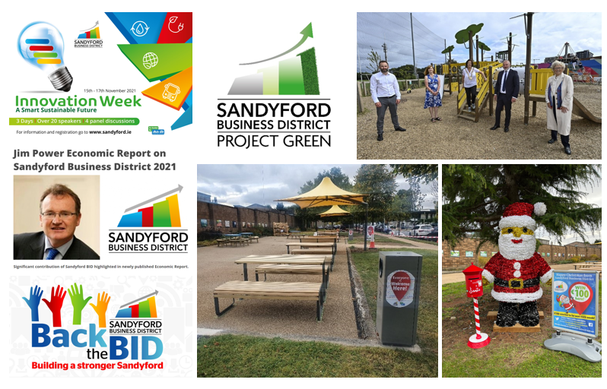
Sandyford Business District Review 2021
Niamh Egan

Slide 2
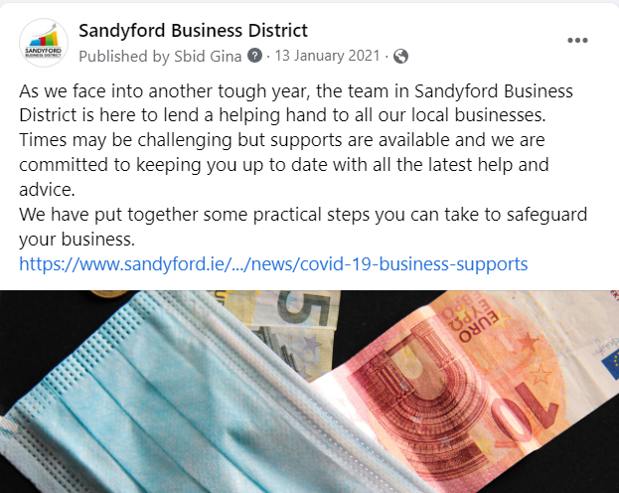
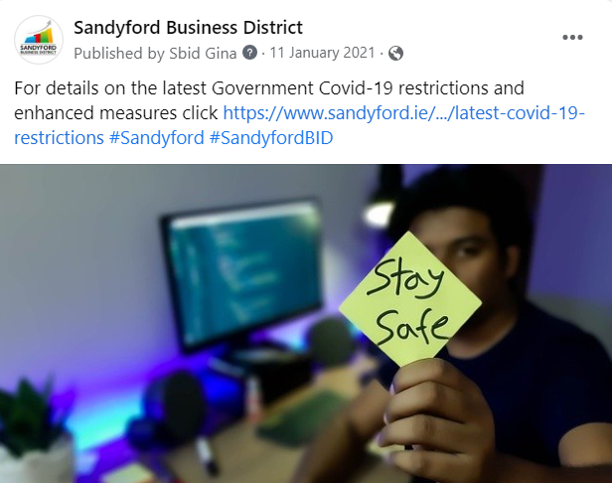
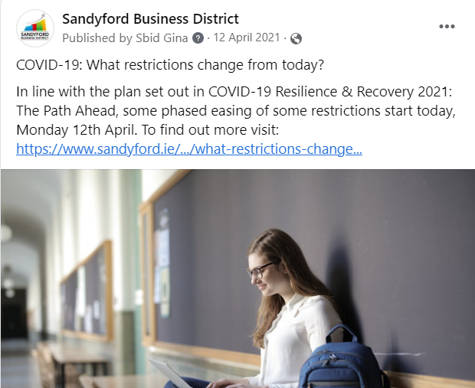
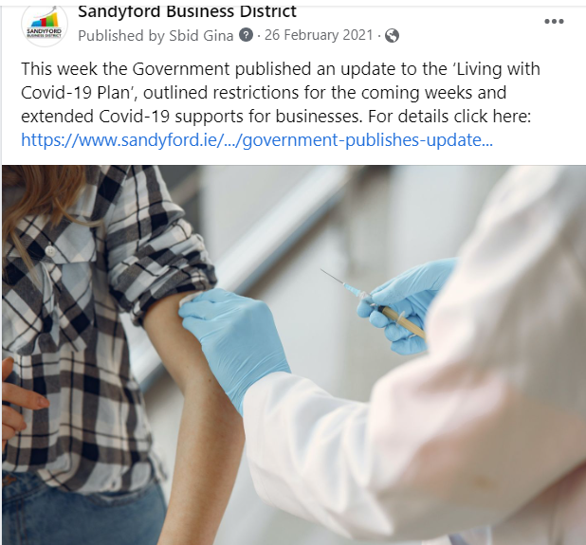
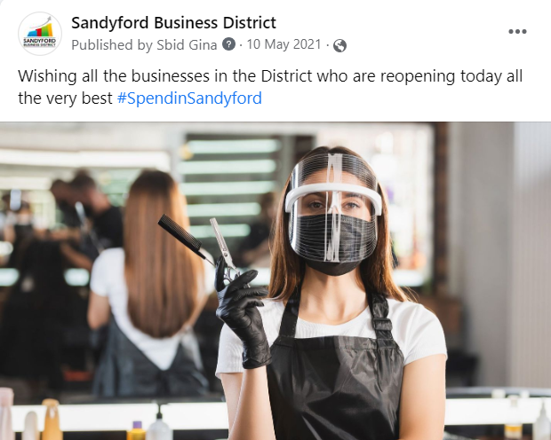
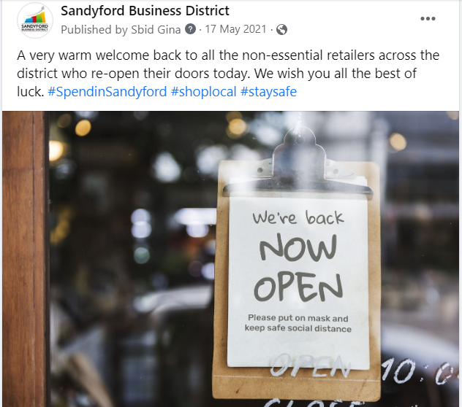
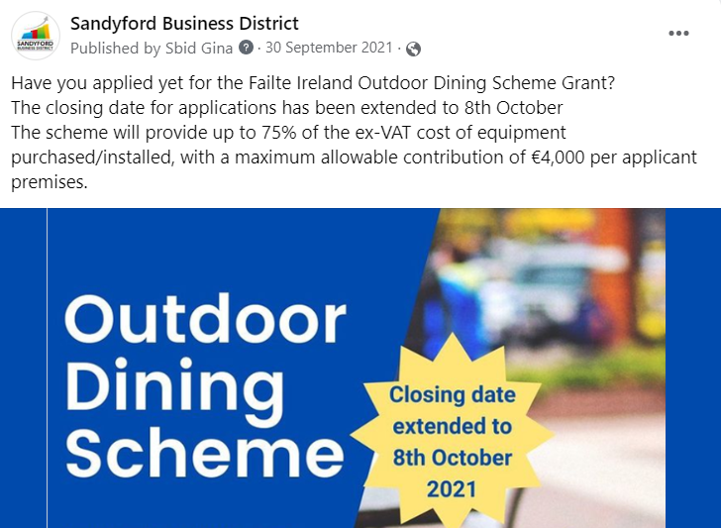
Sandyford Business District Covid Supports
Regular updates on all Government advice, restrictions and available supports,
- Newsletter, Social Media & SBD Website
Practical steps to safeguard businesses

Slide 3
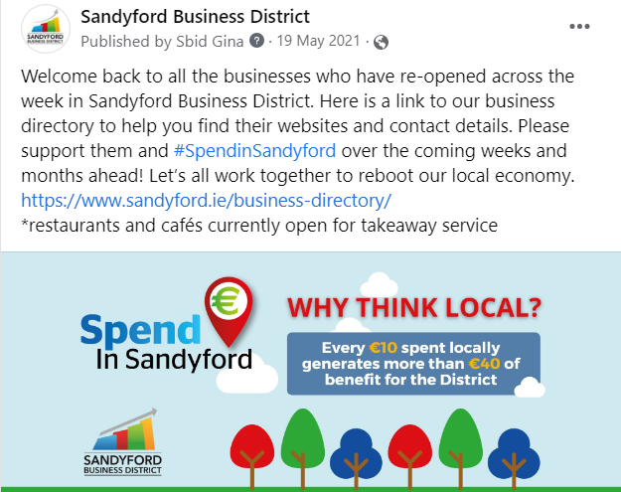
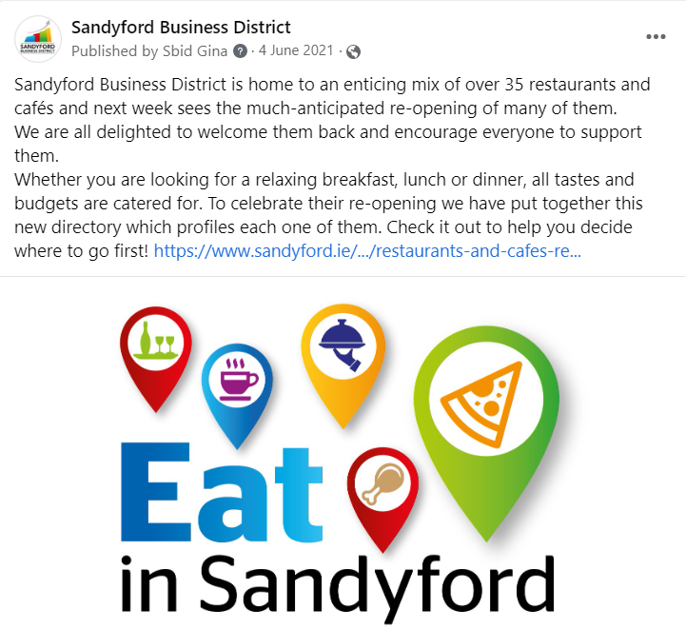
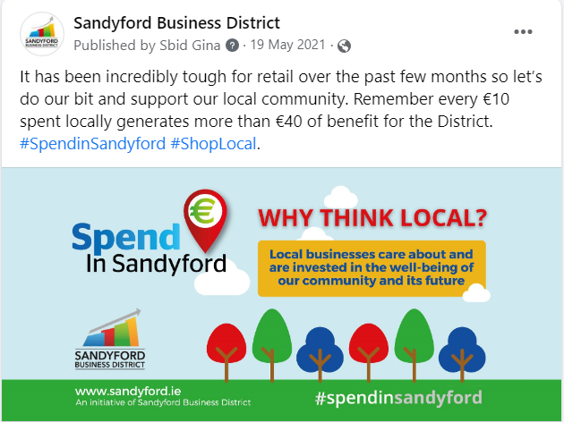
Sandyford Business District Covid Supports – supporting businesses re-opening
“Spend in Sandyford” Campaign:
Marketing for cafés & restaurants doing takeaways during lockdown & on re-opening
Directories for individual sectors as they re-opened (gyms, hair salons, barbers & beauty salons)

Slide 4
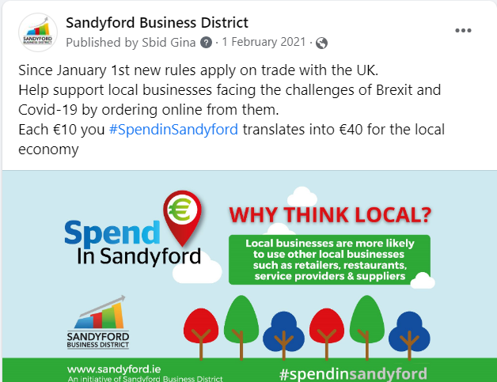
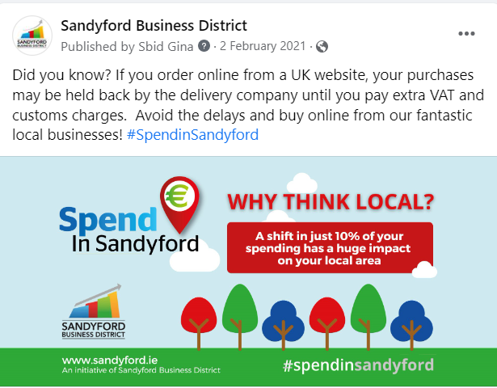
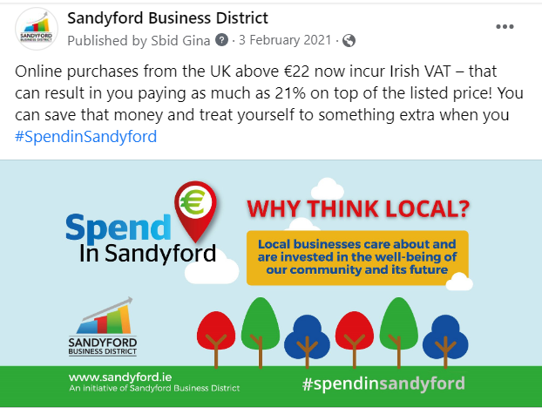
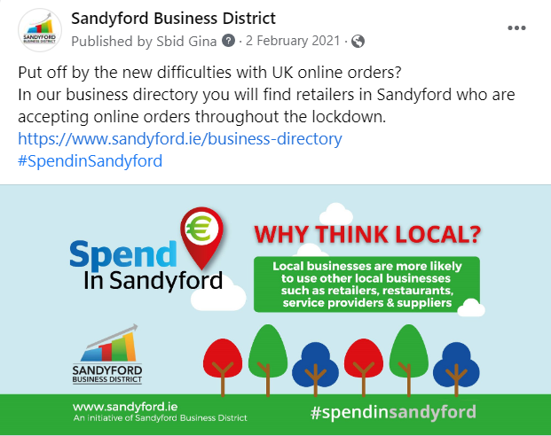
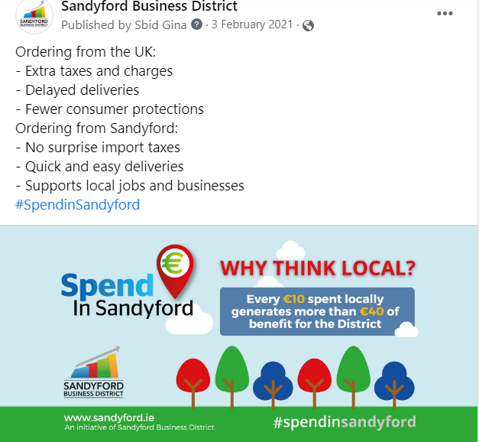
Sandyford Business District Brexit Supports
Regular updates on Government advice and supports available
- Newsletter, social media & SBD Website
Spend in Sandyford Campaign: / Shop local & avoid Brexit challenges

Slide 5
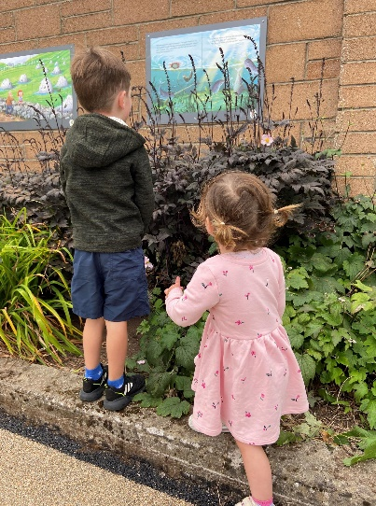
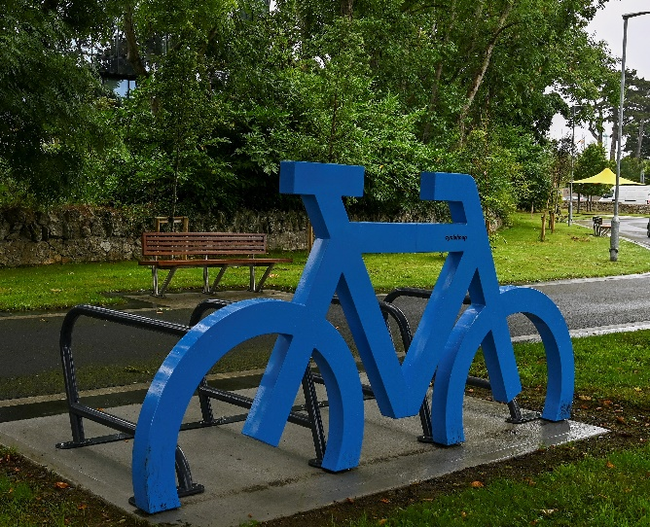
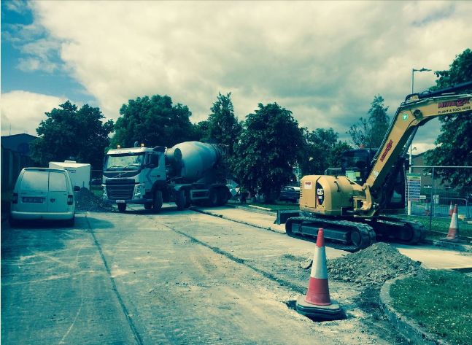
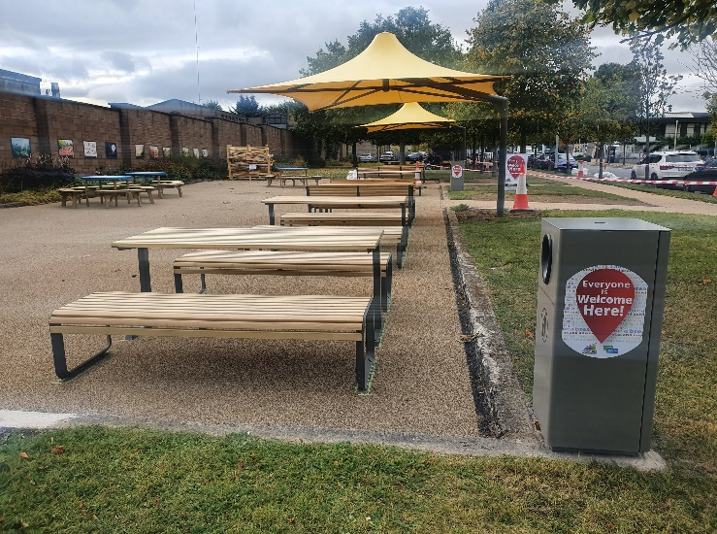
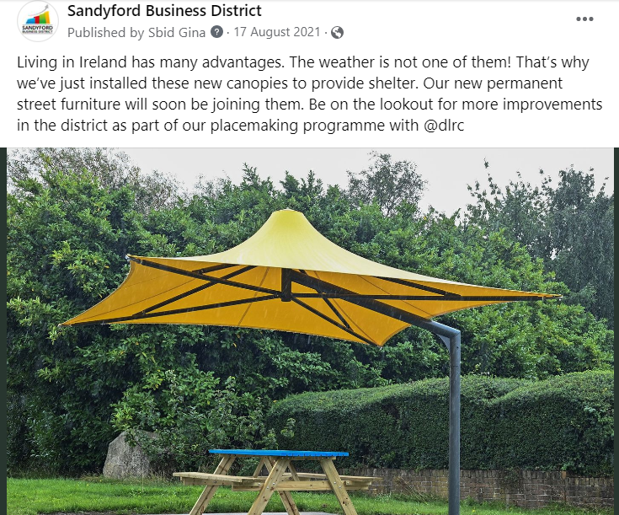
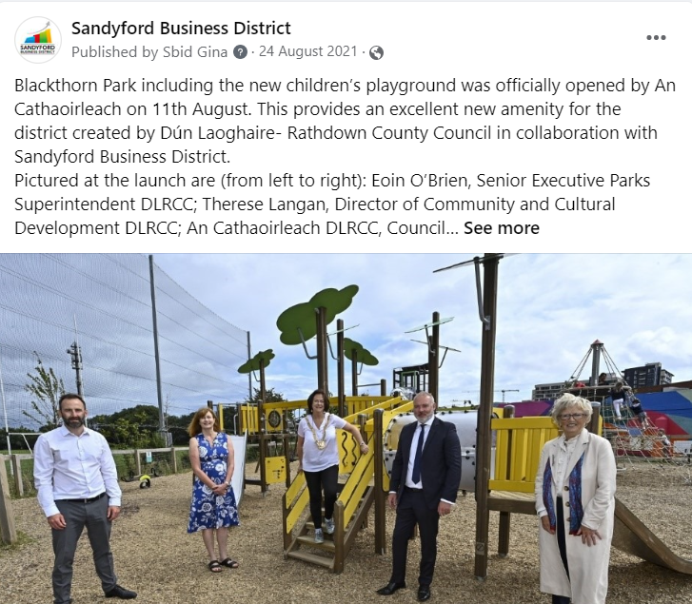
Sandyford Business District Environment & Placemaking
Bracken Road Pocket Park & Scéal Trail
Blackthorn Park including Children’s Playground
Canopies (3)
Picnic Tables & Benches (6)
Rectangle Benches (13)
Bike Racks (2)

Slide 6
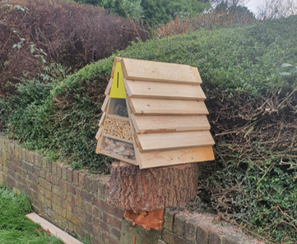
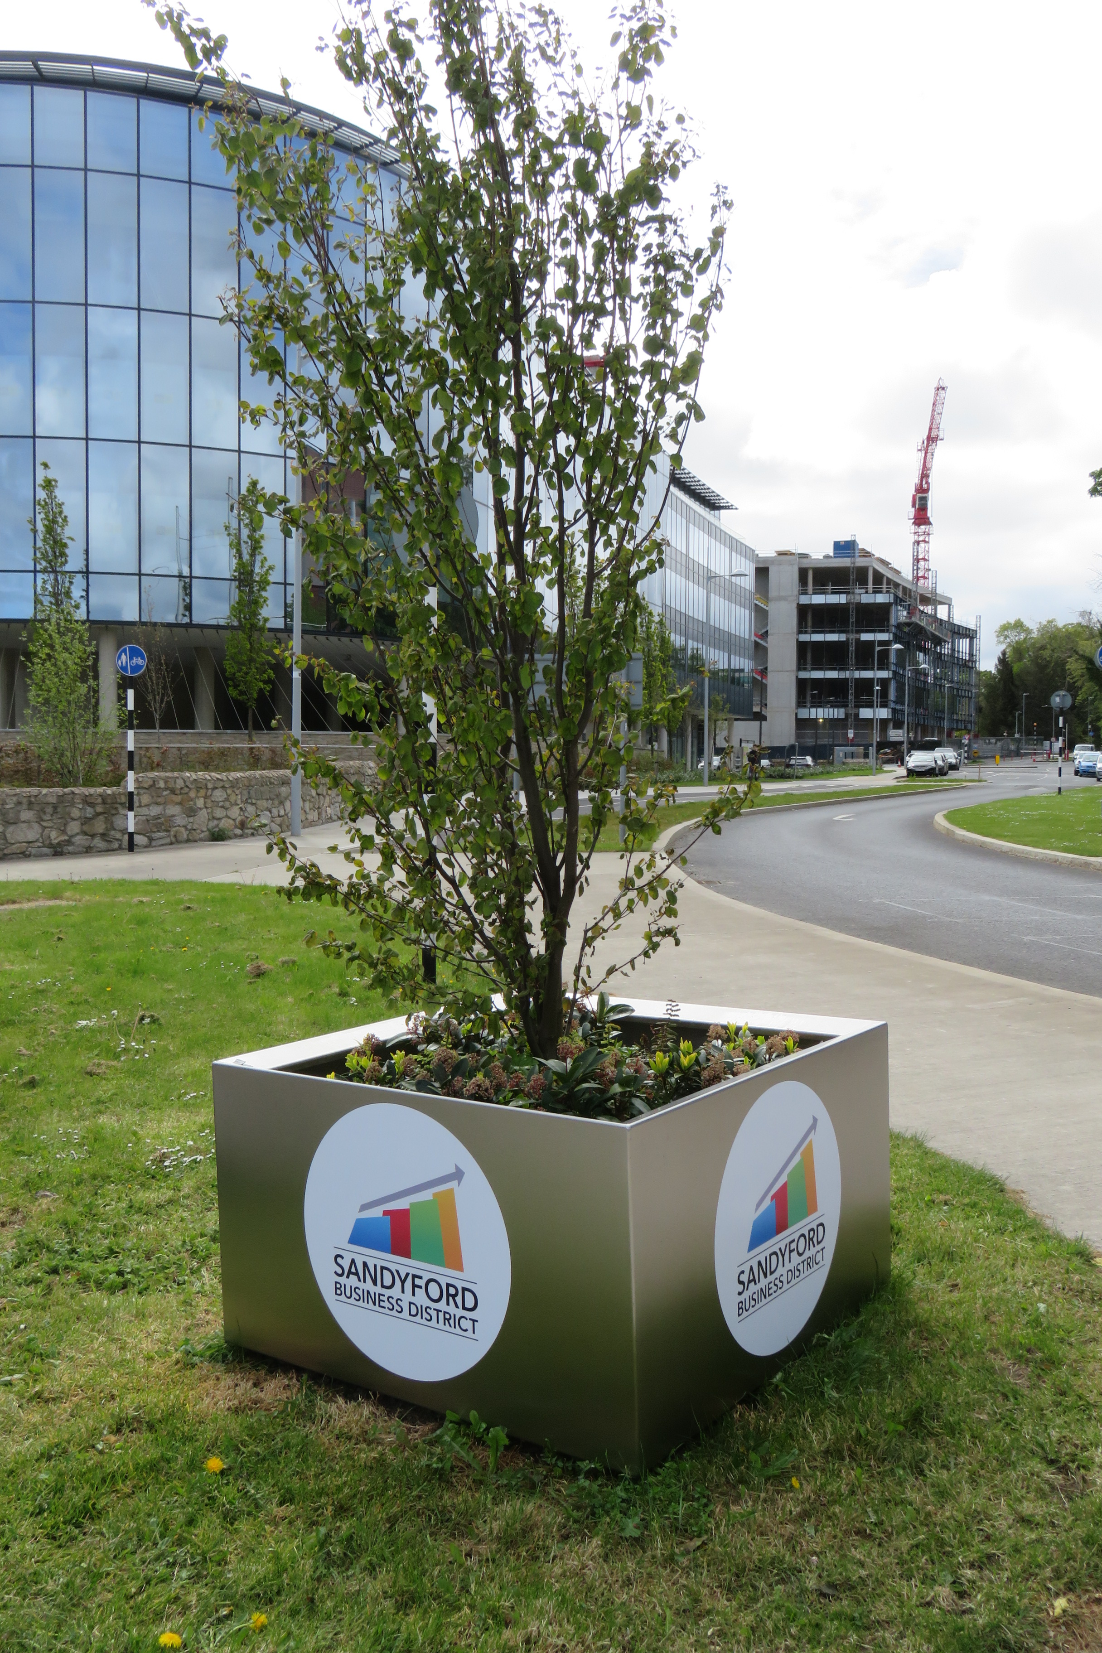
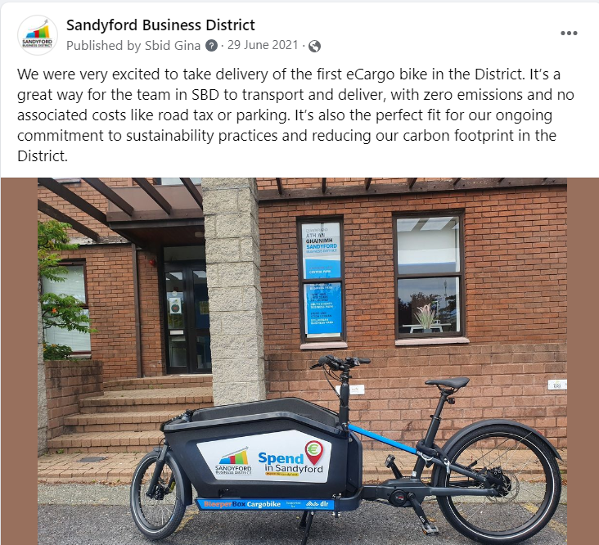
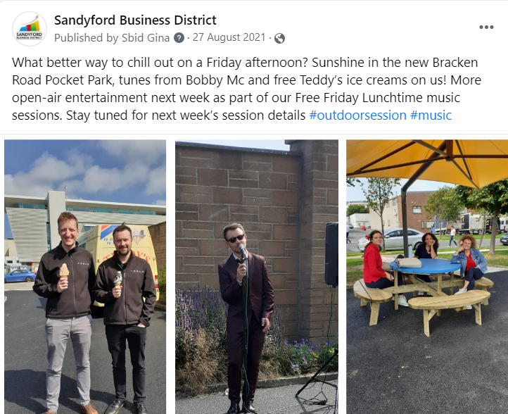
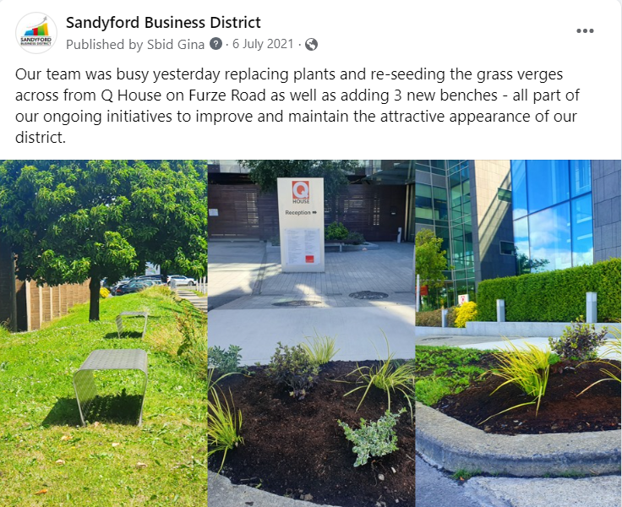
Sandyford Business District Environment & Placemaking
Planting & re-seeding
New Insect Hotels
E-cargo Bike trial
“Free Friday Lunchtime Music Sessions” (& Teddy’s Ice Cream)

Slide 7
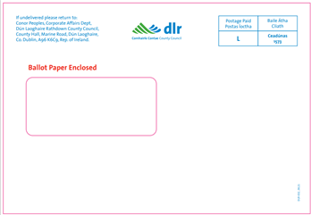
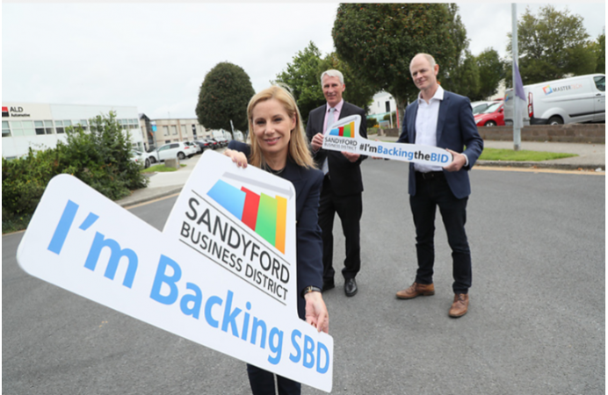
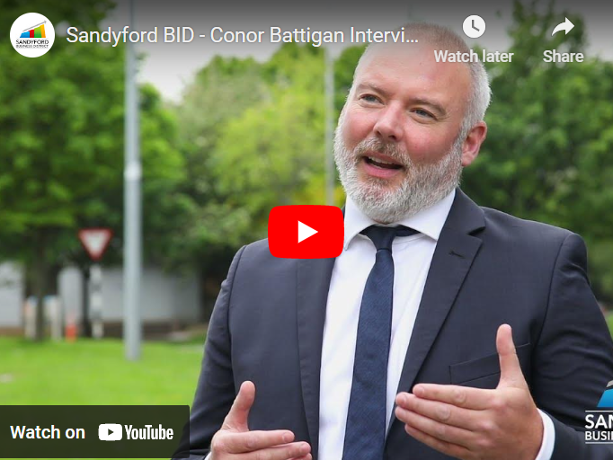
Sandyford Business District Plebiscite
Through-the-line Marketing Campaign June 14th – September 30th
Official campaign launch
Direct Email campaign
Dedicated Webpage: Vote / Back the BID
Jim Power Economic Report
Sandyford by the numbers
Sandyford BID - the 1st 5 years
Sandyford BID - the next 5 years
“Did you know…?” campaign / Reasons to choose Sandyford
Wellness Week September 27th – October 1st
SBD Business Impact Awards – November
Innovation Forum November 15th – 17th

Slide 8
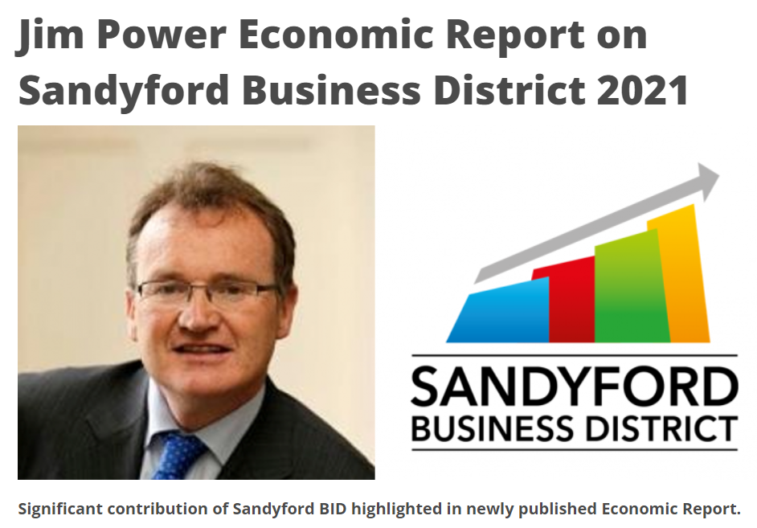
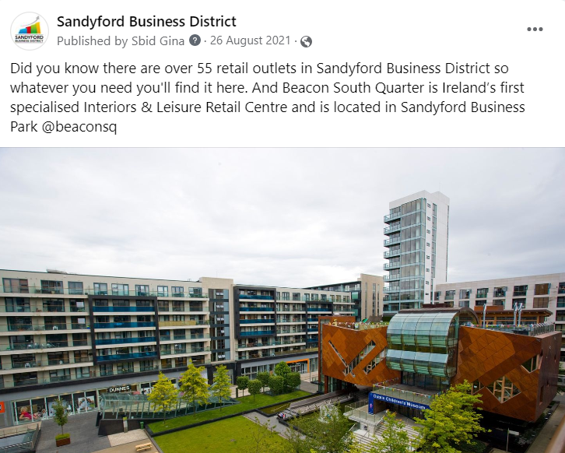
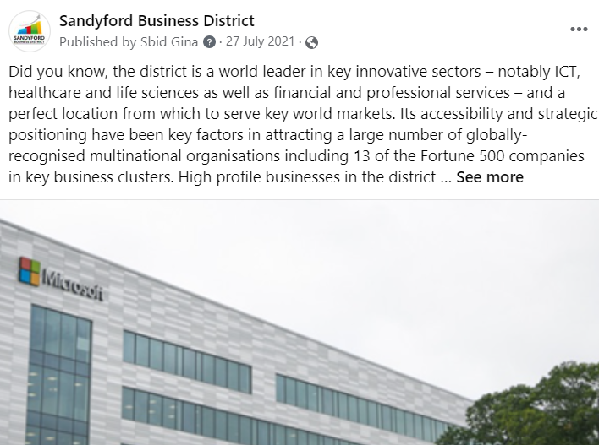
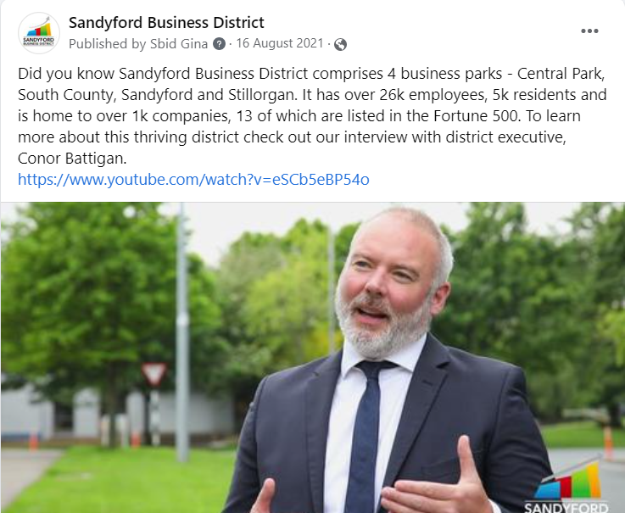
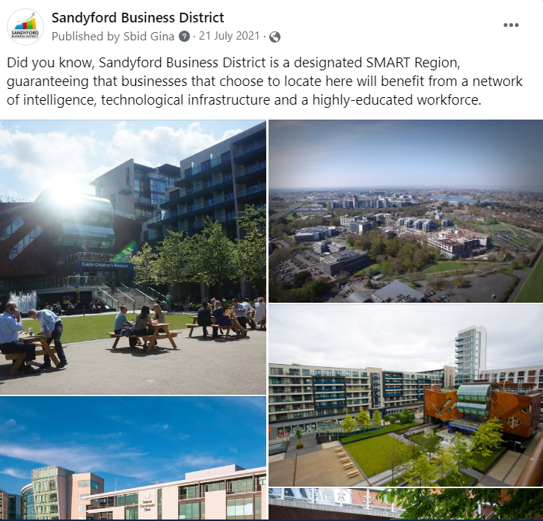
Sandyford Business District Plebiscite
“Did you know…?” campaign / Reasons to choose Sandyford

Slide 9
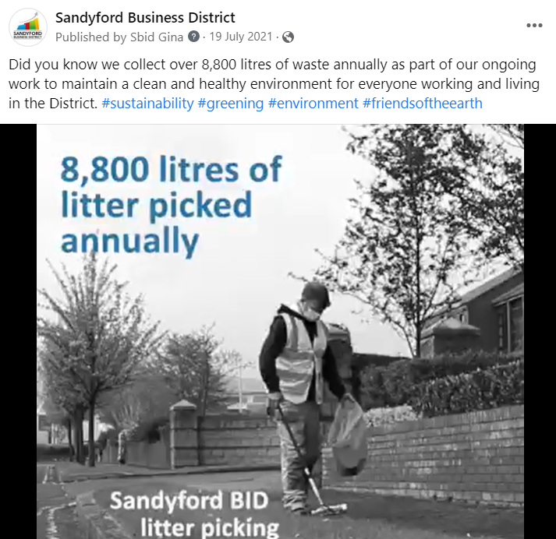
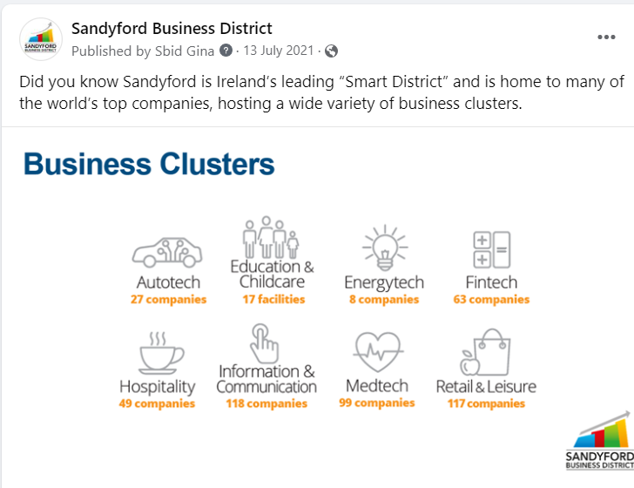
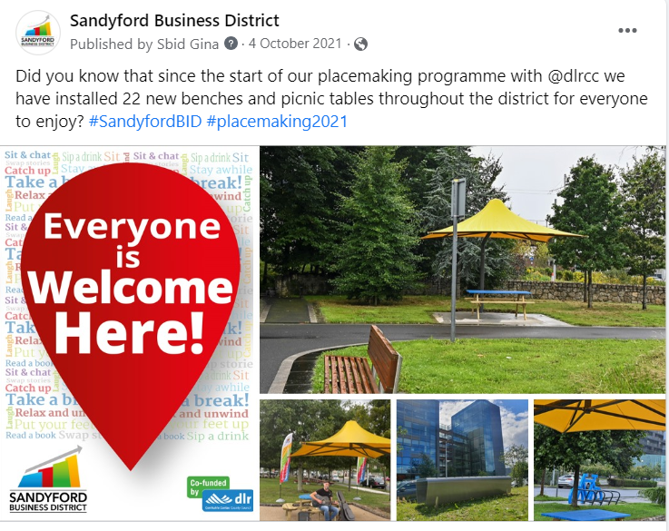
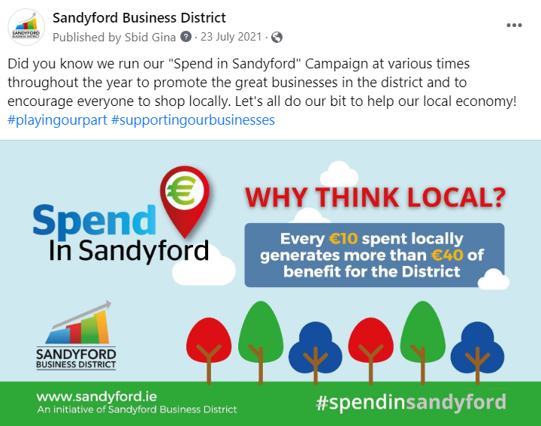
Sandyford Business District Plebiscite
“Did you know…?” campaign / Reasons to choose Sandyford

Slide 10
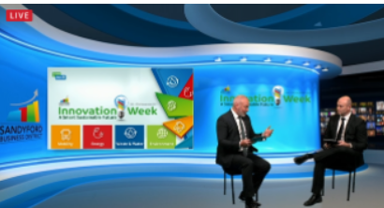
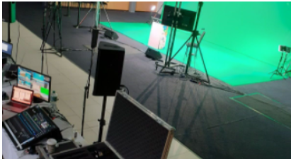
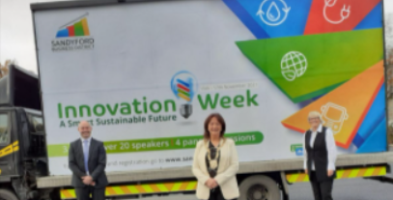
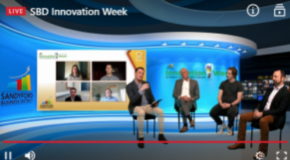
Sandyford Business District Events
Innovation Week November 15th – 17th
Online event focusing on four pillars - energy, environment, waste & water and mobility
4 sessions
35 panel speakers
283 registered online

Slide 11
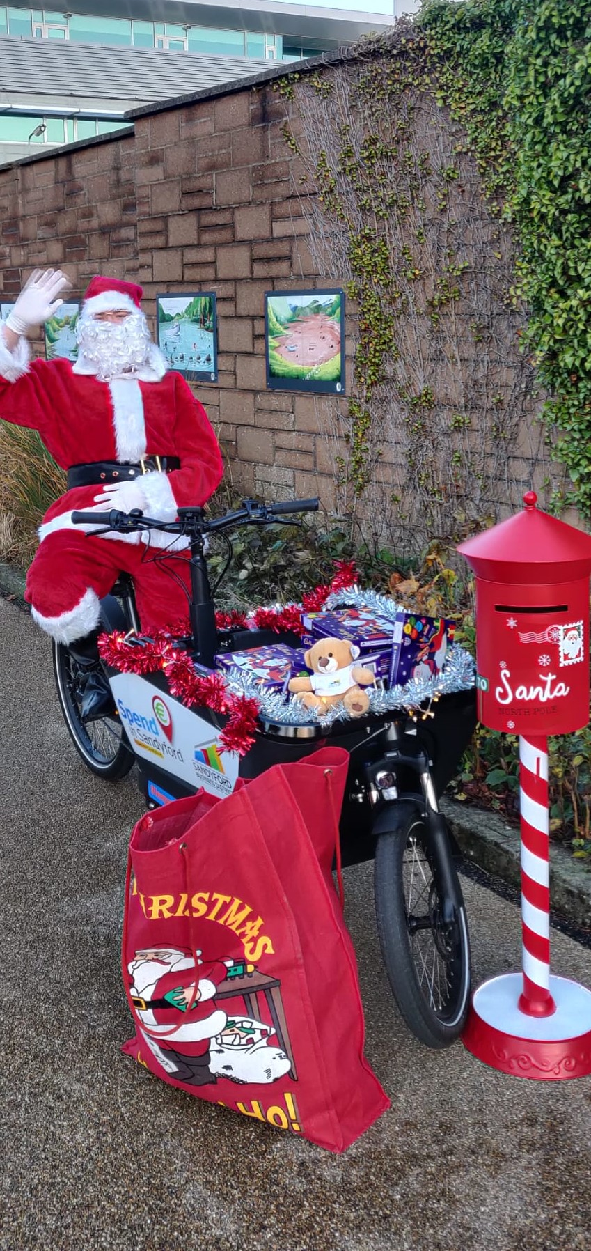
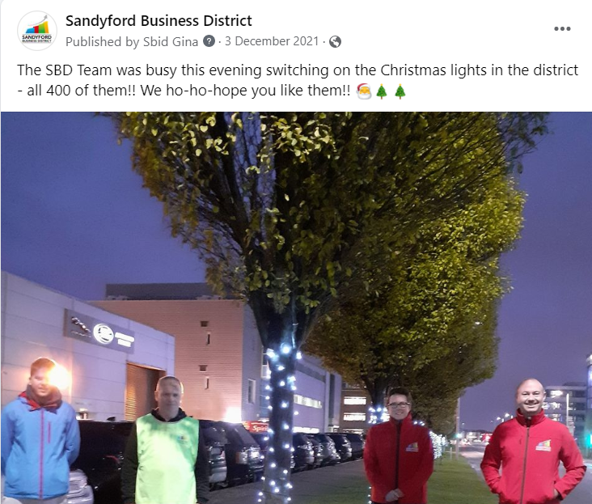
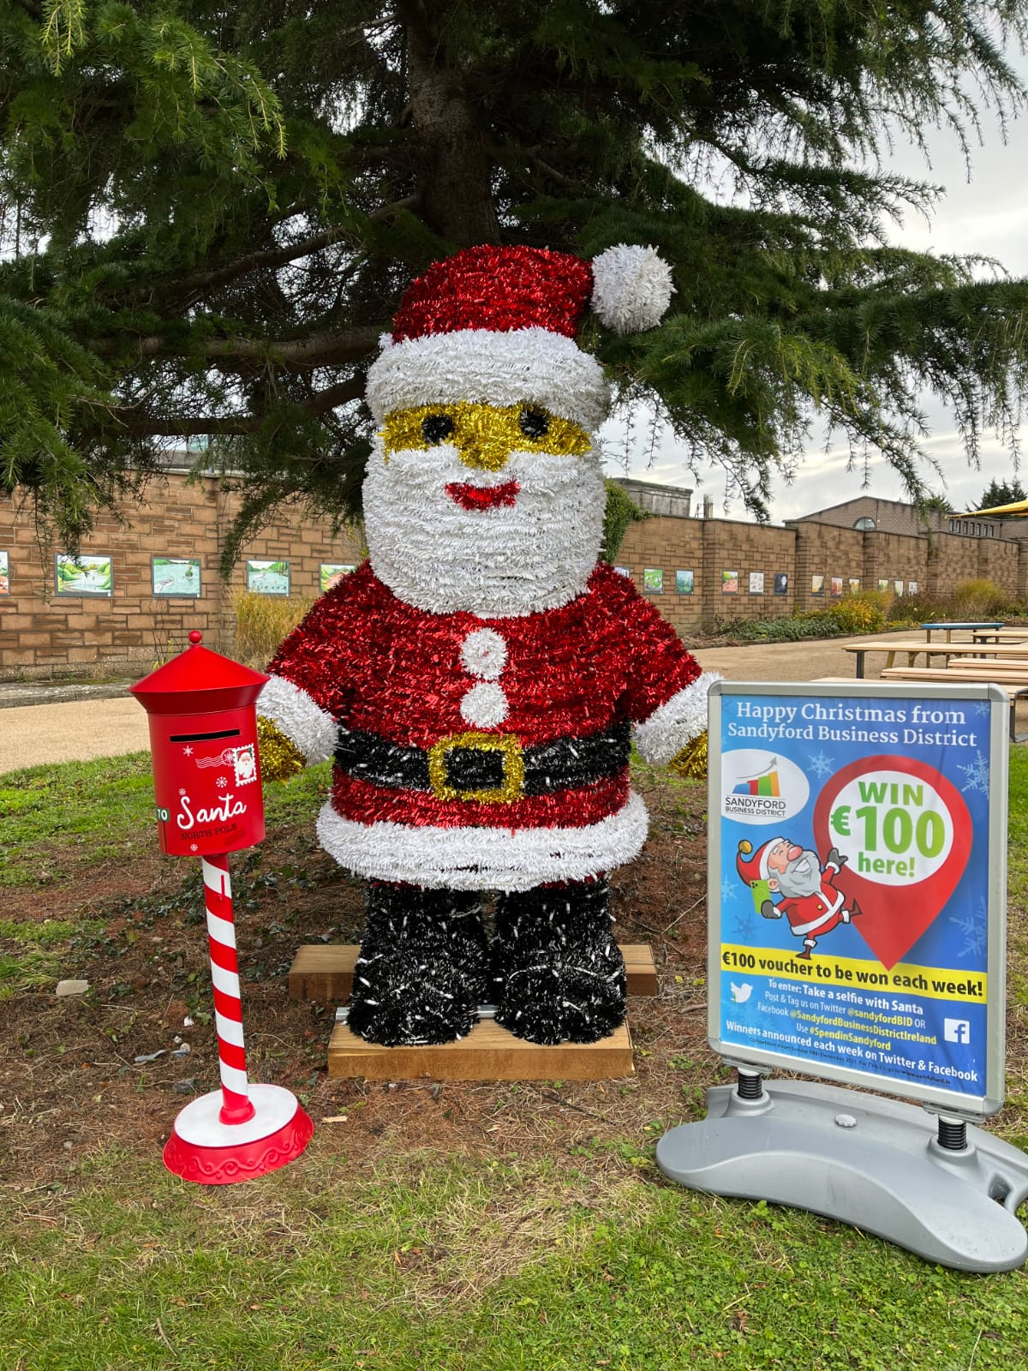
Sandyford Business District Events
Wellness Week September 27th – October 1st
Business Impact Awards – November
Residents’ Halloween Party
Winter Festival (Christmas lights, Residents’ outdoor party, Free Taxi Service )

Slide 12
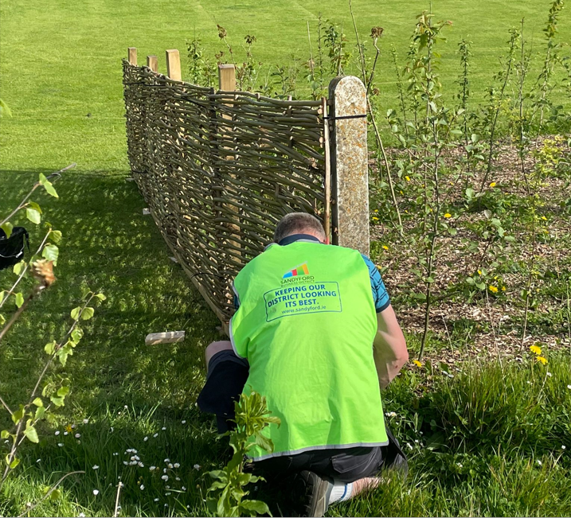
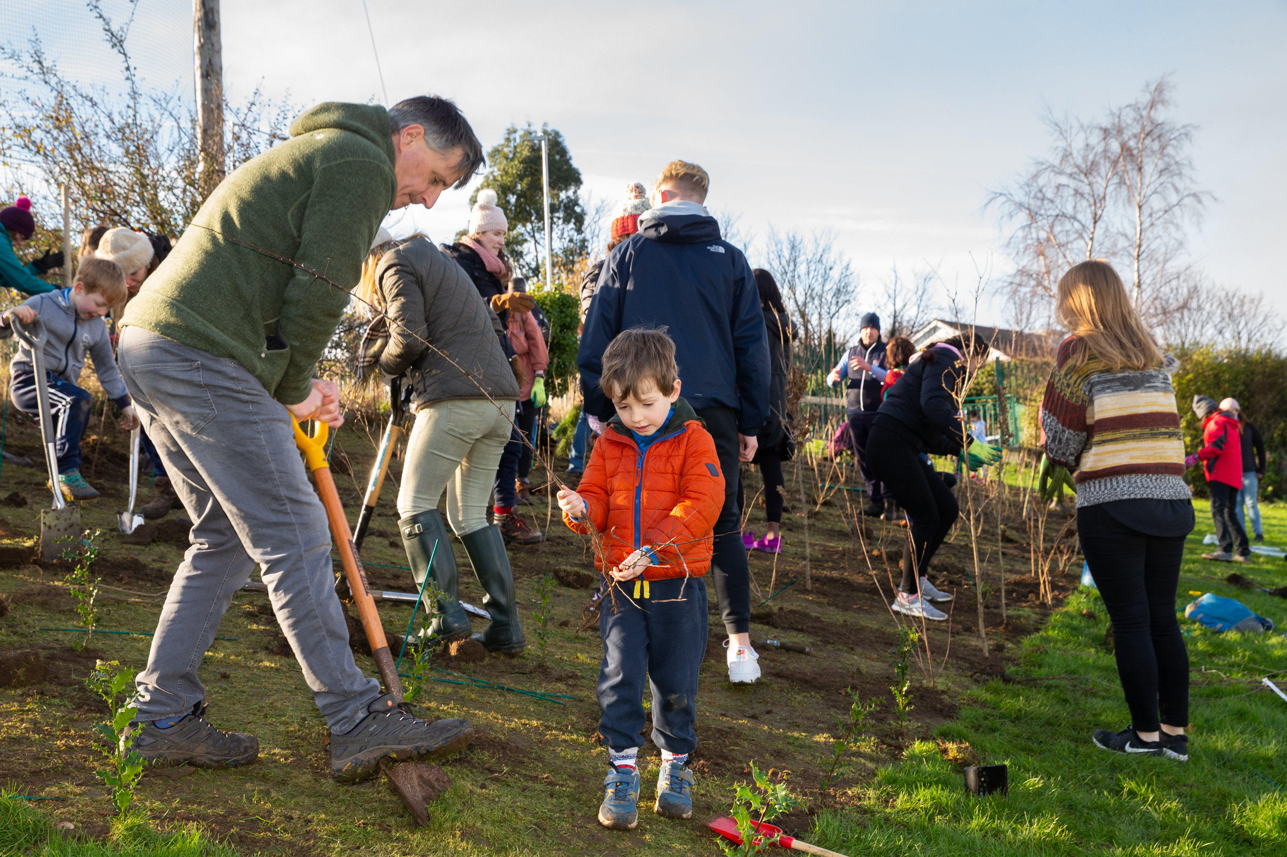
Sandyford Business District Project Green
Project Green - created in 2021 to focus on Sustainability in the District.
Project Green committee setup on the back of this.
1st environmental project was planned (pocket forest for the following spring)

Slide 13
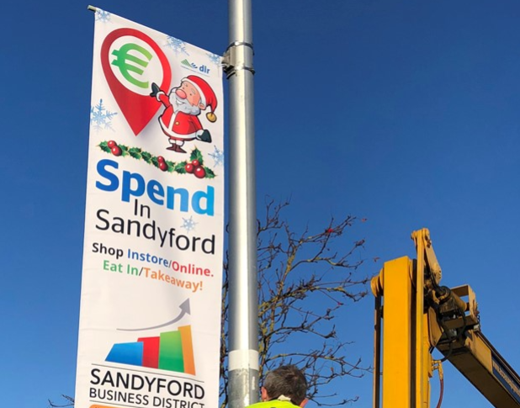
Spend in Sandyford Campaigns
Eat in Sandyford
Fitness Fun & Facials in Sandyford
Spend in Sandyford Easter Campaign
Spend in Sandyford this Valentine’s Day
Spend in Sandyford this Mother’s Day
Spend in Sandyford Christmas Campaign: District Christmas Shopping Directory
12 Businesses of Christmas Promotion

