Slide 1
Sandyford Business Review 2022
Niamh Egan

Slide 2
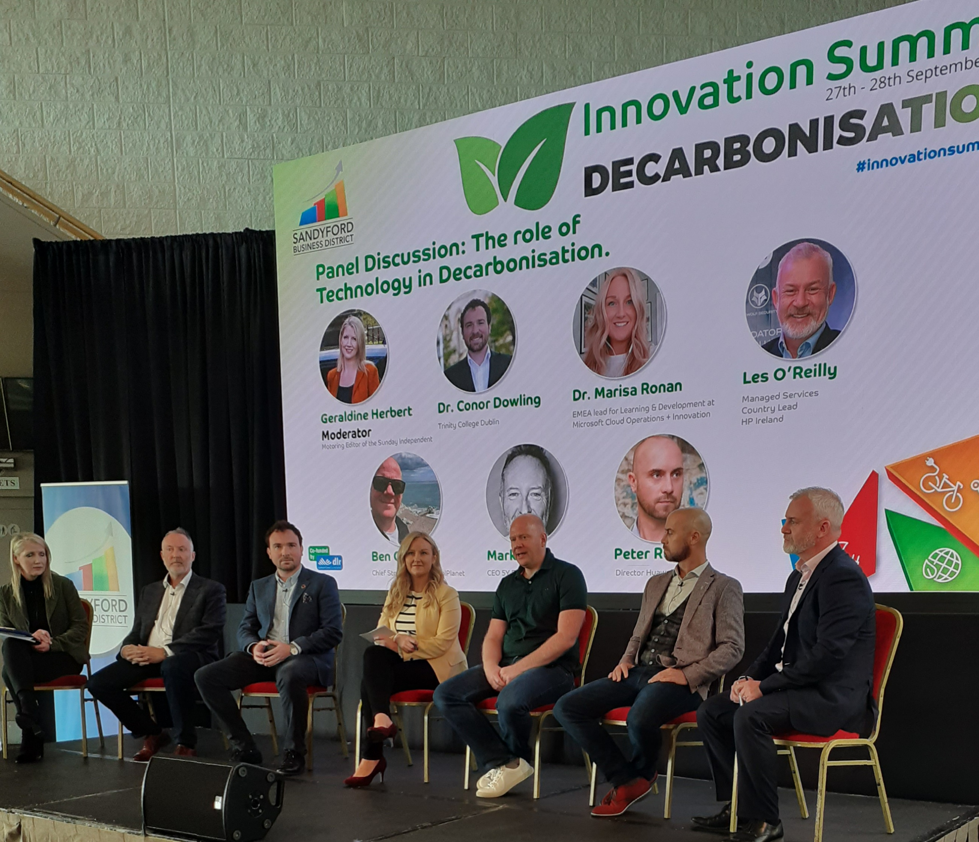
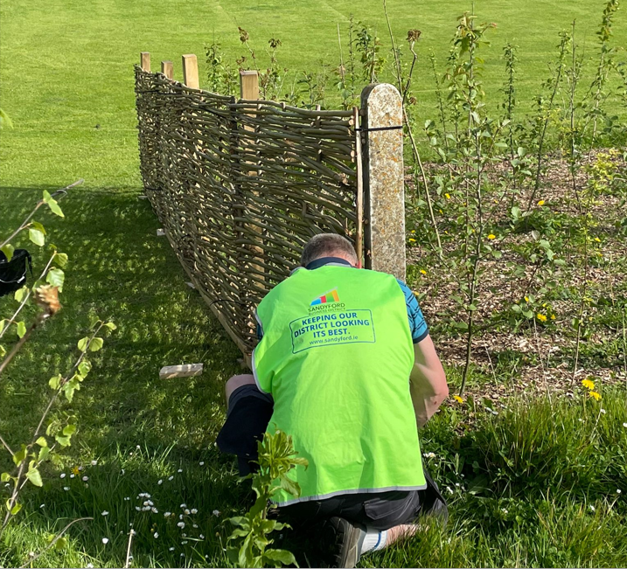
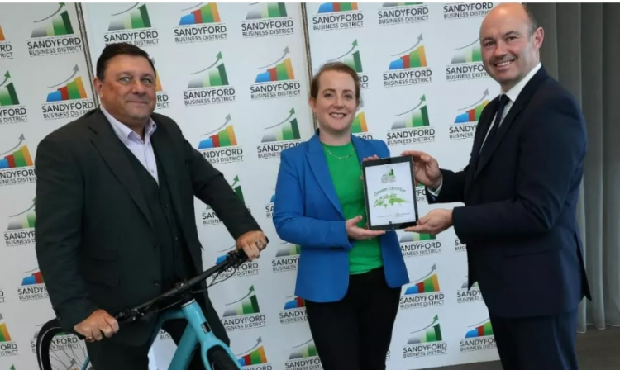
Sandyford Business District Project Green / Green Charter highlights
Sandyford Business District FLAGSHIP EVENT: Innovation Summit 2- Day Event on Decarbonisation in Leopardstown Racecourse
SBD CEO speaks about Green Mobility at the Smart City Expo World Congress in Barcelona
SBD meeting with Climate Alliance Group and 7 other Districts from North Western Europe in Frankfurt as part of a joint effort to apply for EU funding towards Green Infrastructure improvements within the District.
Launched SBD Green Charter in partnership with Mayo-based centre for change, The Mary Robinson Centre.
SBD plants first pocket forest in the district in Naomh Ólaf GAA Club.

Slide 3
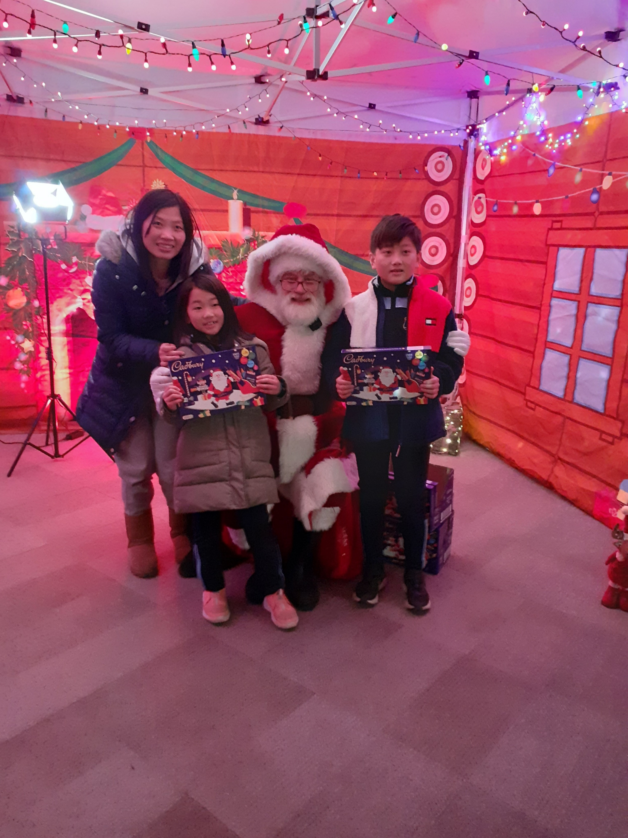
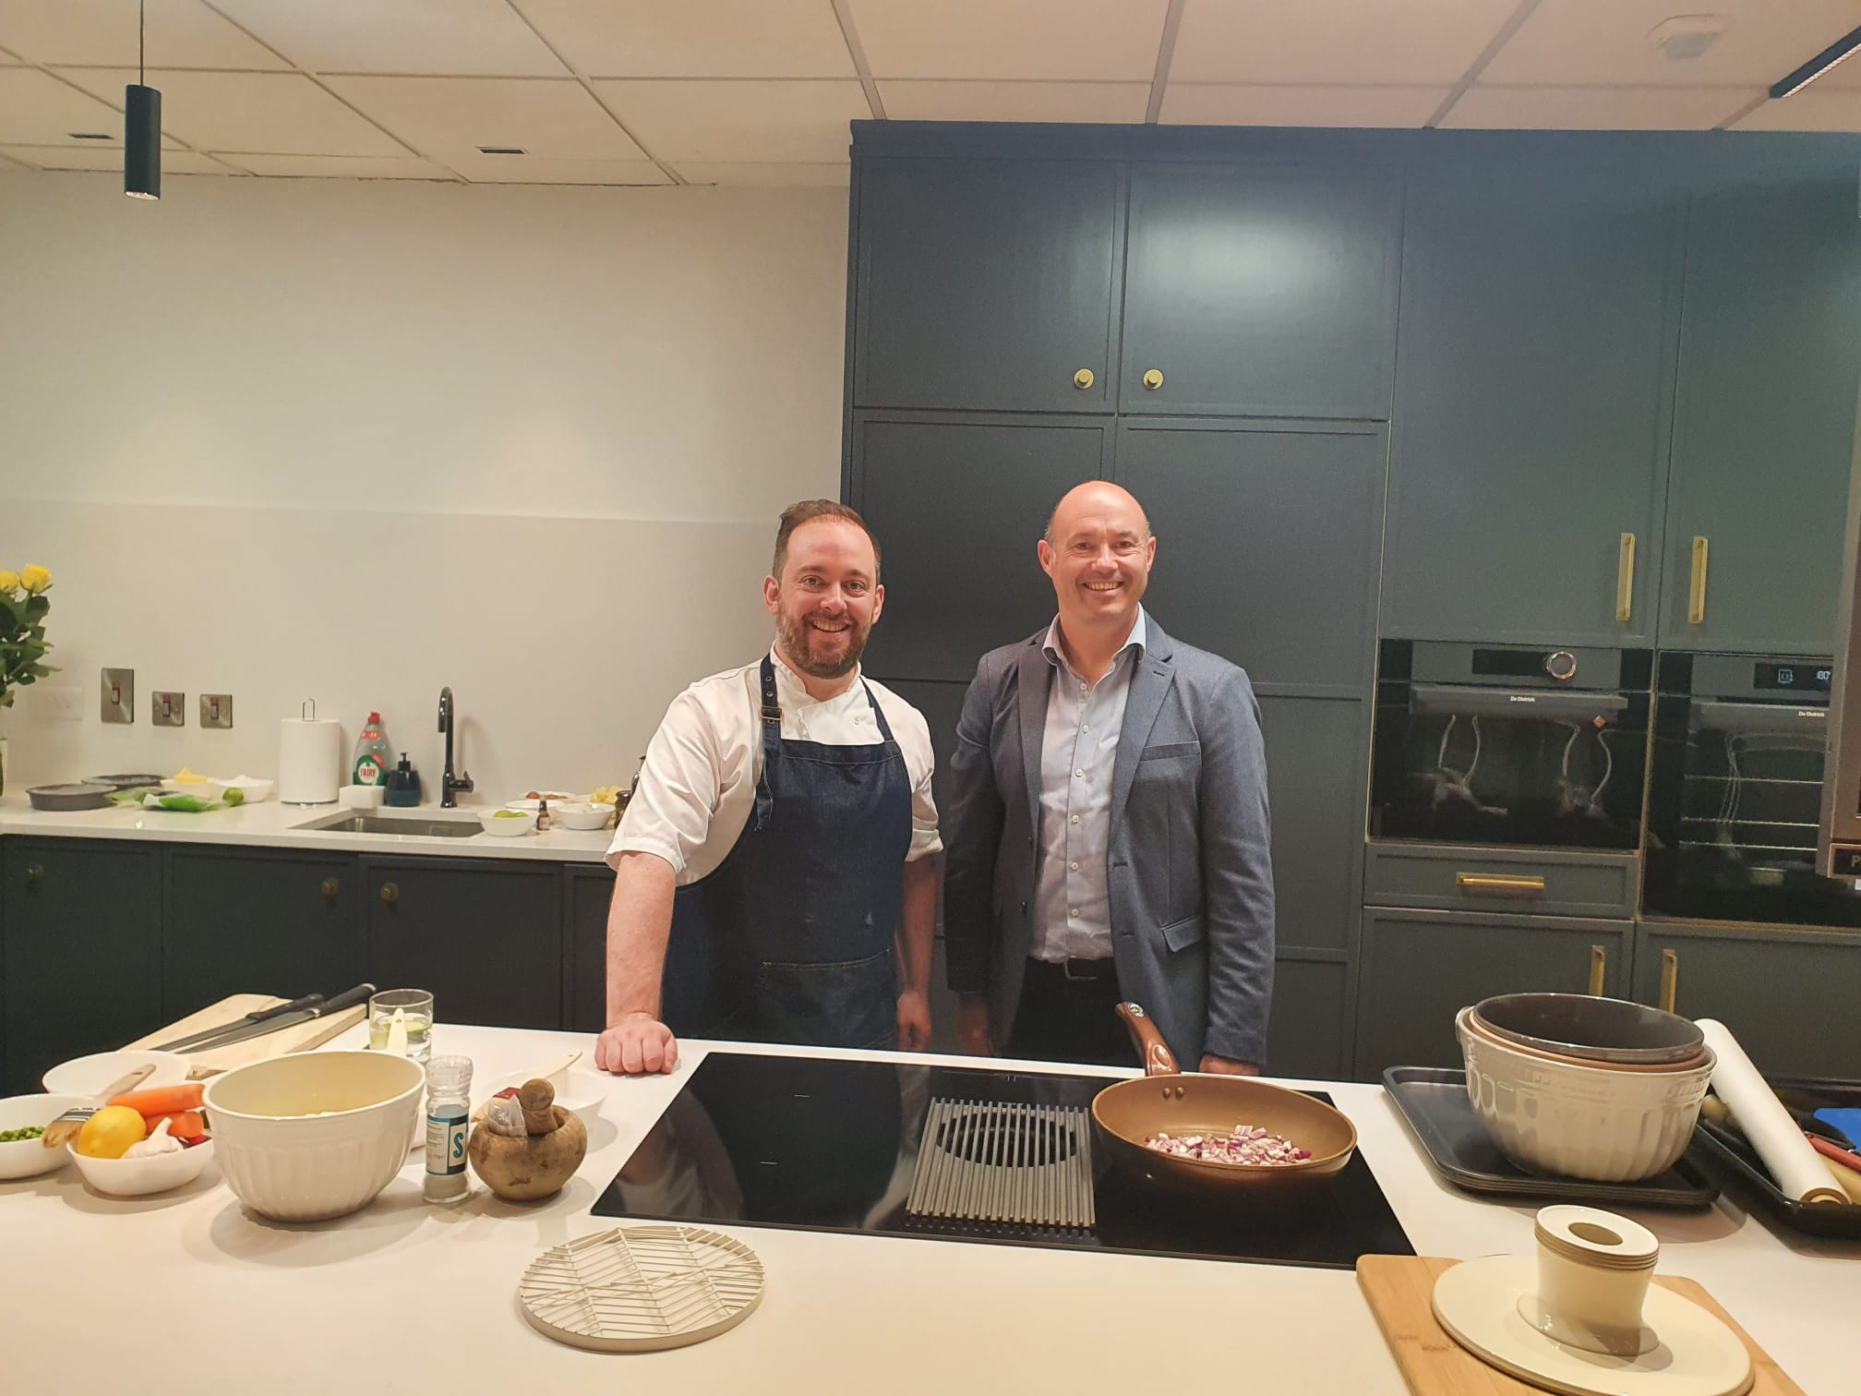
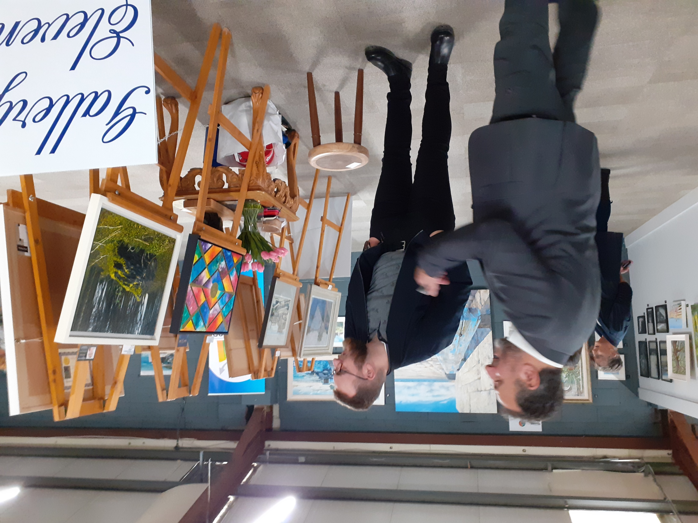
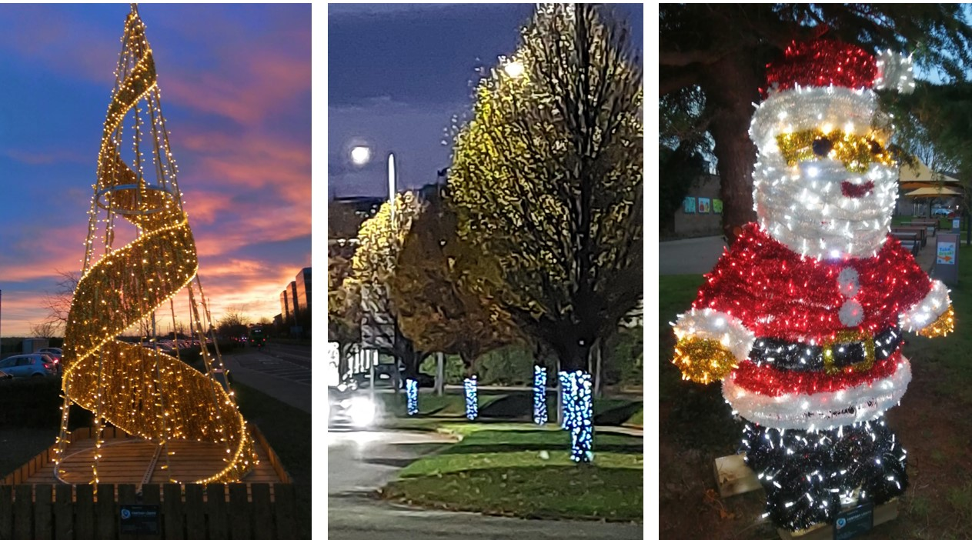
Sandyford Business District Events
SBD Wellness Week April 4th – 8th
SBD Winter Festival (Christmas lights, Craft Fair, Santa Experience)
SBD Culture Night: International Cookery Event
Culture Night: Art Exhibition
SBD Digital 1st Day in conjunction with DigitalX and Hub17
SBD Feel Good Friday in partnership with Leopardstown Racecourse

Slide 4
Spend in Sandyford Campaigns
Spend in Sandyford Easter Campaign
Spend in Sandyford this Valentine’s Day
Spend in Sandyford this Mother’s Day
Spend in Sandyford Christmas Campaign: District Christmas Shopping Directory and
12 Businesses of Christmas Promotion
In addition: Our fortnightly e-newsletter “In the Loop” features a “Spotlight” profile on an individual business in each edition. It also offers free advertising to all District businesses to promote their business/news/everts/offers etc Plus, our various competitions across social media at key seasonal times promoted local businesses with vouchers and giveaways

Slide 5
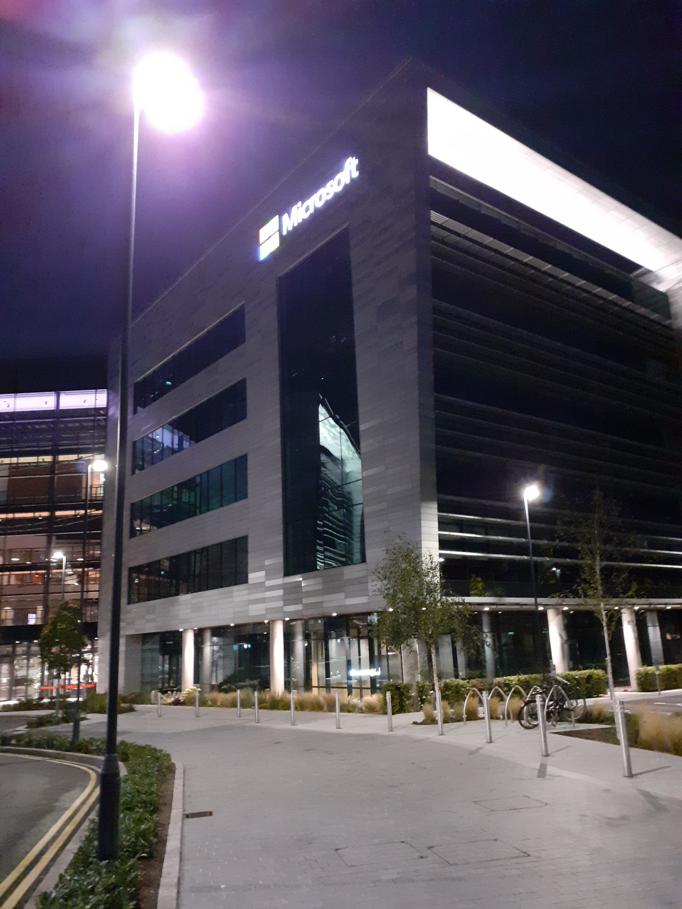
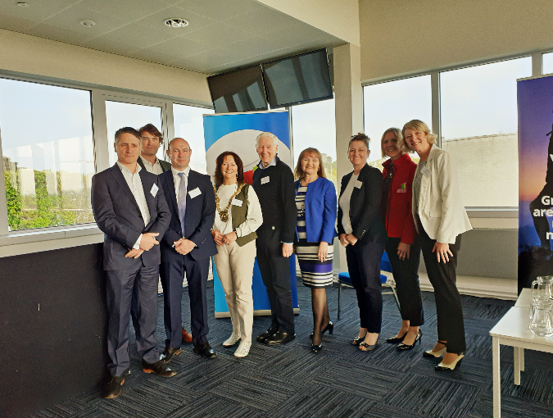
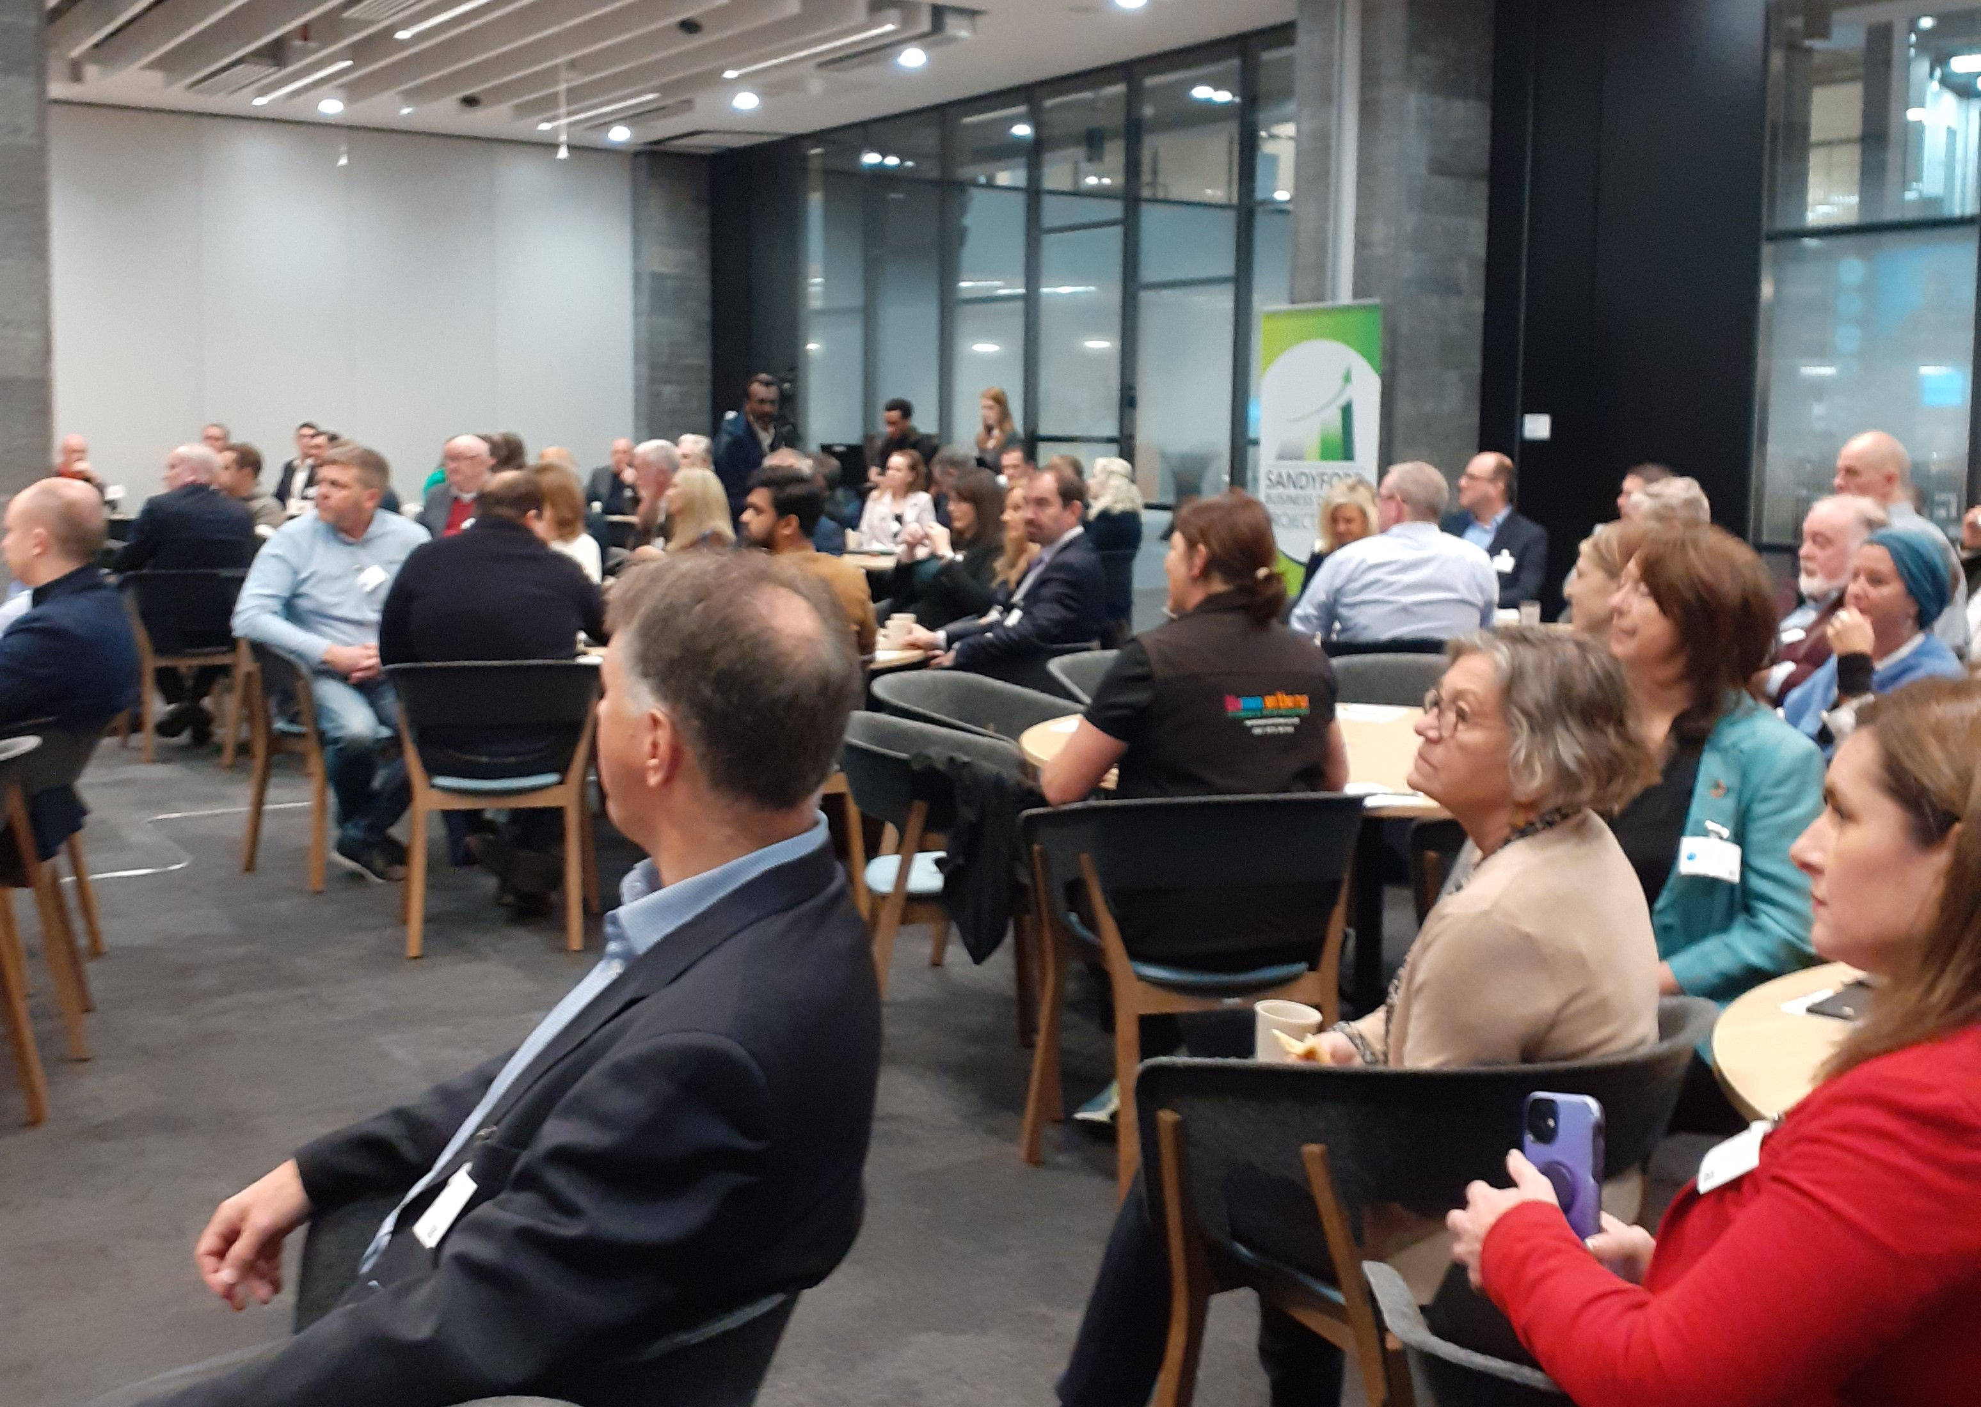
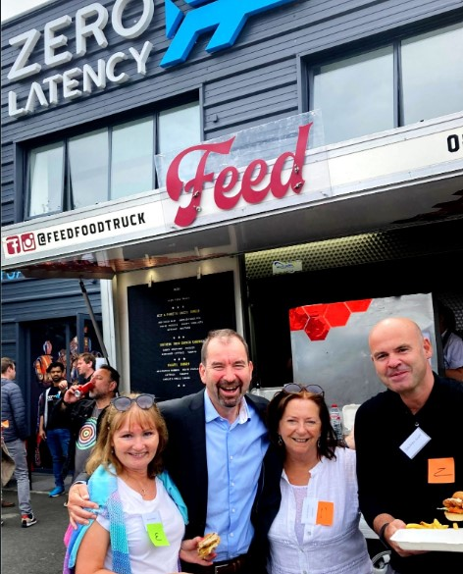
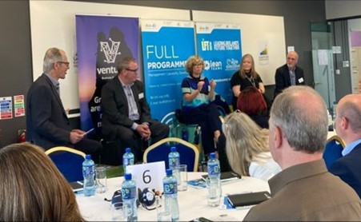
Sandyford Business District Business Networking Events
SBD holds 1st Business Networking Breakfast Meeting in Leopardstown Racecourse
SBD holds 2nd Business Networking Breakfast Meeting in Covalen
SBD holds Summer Social Business Networking Event in Zero Latency
SBD 4th Business Networking Breakfast Meeting in Microsoft

