Slide 1


TU RISE Elevate Programme is co-funded by the Government of Ireland and the European Union through the ERDF Southern, Eastern & Midland Regional Programme 2021-27

Slide 2

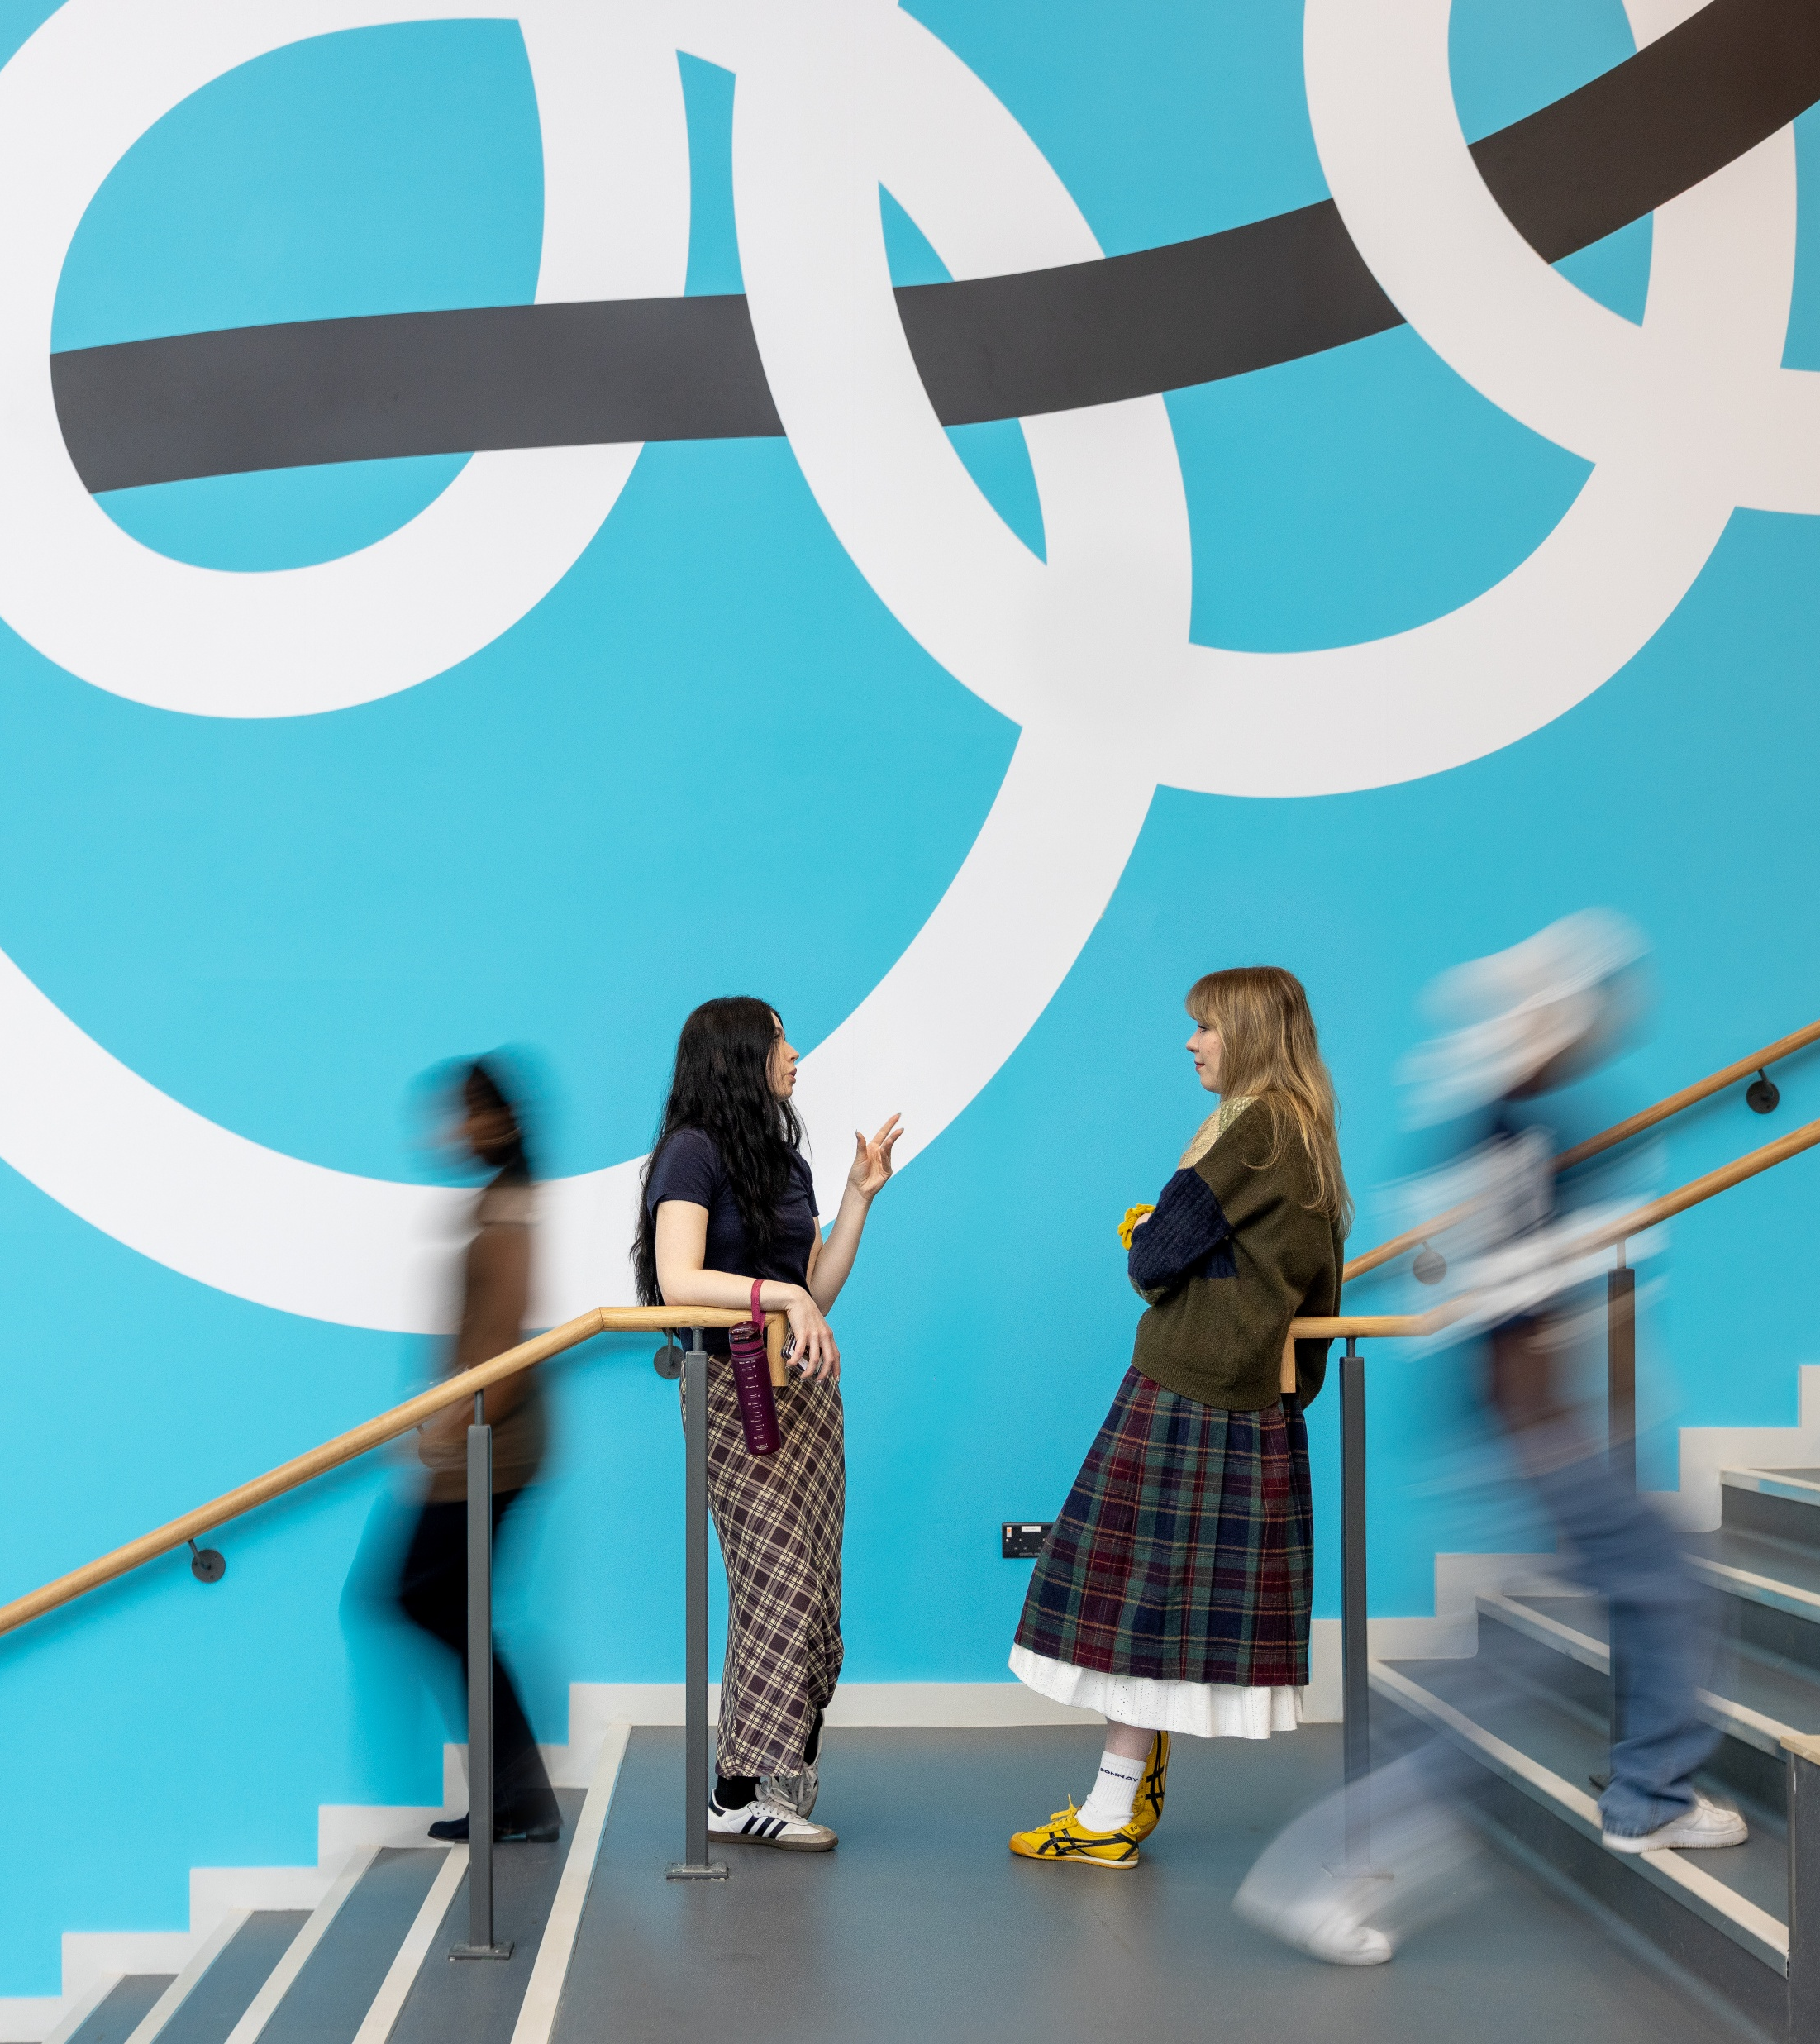
About IADT
Ireland’s Campus for the Creative Industries
Over 2,500 students across film, design, psychology, business, computing, creative tech
World-class facilities and specialist environments – including the National Film School, our Digital Media Building, Immersive Studio, and industry-grade production spaces
Expert teams spanning design, screen, immersive technologies, digital psychology, and inclusive innovation
A strategic partner in innovation and impact - active in Enterprise Ireland, Horizon Europe, and regional innovation through TU RISE and ERDF

Slide 3




How We Work with Industry
Industry-Academic Innovation
Innovation Collaborations
Co-design of projects
Structured collaborative research
Exchange of Knowledge & Experience
Structured workshops
Hackathons
Site visits
Co-creation labs
Masterclasses
Placements
Student placements
Industry Immersion Days
Mentoring programmes
Training
Specialised training for enterprise
Structured workshops
Seminars/webinars
Masterclasses

Slide 4

Collaboration In Action:
Innovation Collaborations

Slide 5

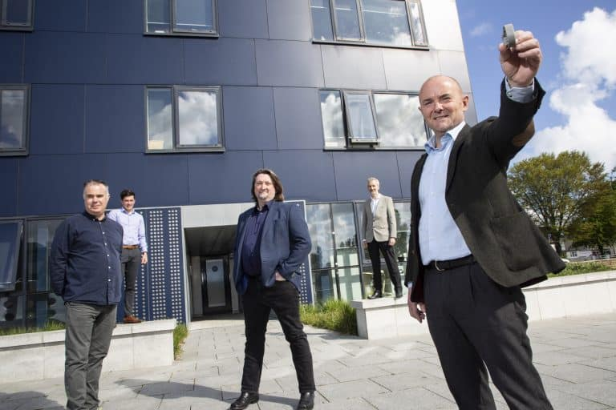
Enterprise Ireland Innovation Vouchers
Allows SME’s to access €10,000 worth of time with an expert, third-level researcher to help you develop an idea or product, or crack a business or technical challenge.
PacSana X IADT
PacSana designs wearable technology for older people, detecting changes in daily movement to flag potential health incidents at home.
Collaboration Details
PacSana collaborated with IADT to enhance the user experience of their wearable. Senior researcher Julian King (3D Design & Model-making) spearheaded the initial prototype development. A second voucher supported mobile app UX/UI and cyber‑psychology research, led by Robert Griffin.
Impact:
IADT’s expertise enabled PacSana to demonstrate a tangible prototype, vital for engaging suppliers and investors.
The partnership contributed directly to PacSana securing €650,000 in follow-on funding, supporting their expansion into the U.S. home-care market

Slide 6
Collaboration In Action:
The Innovate Lab

Slide 7
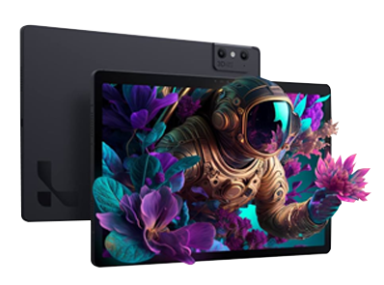
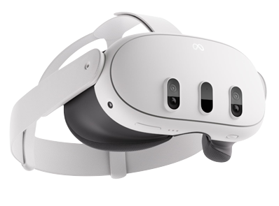
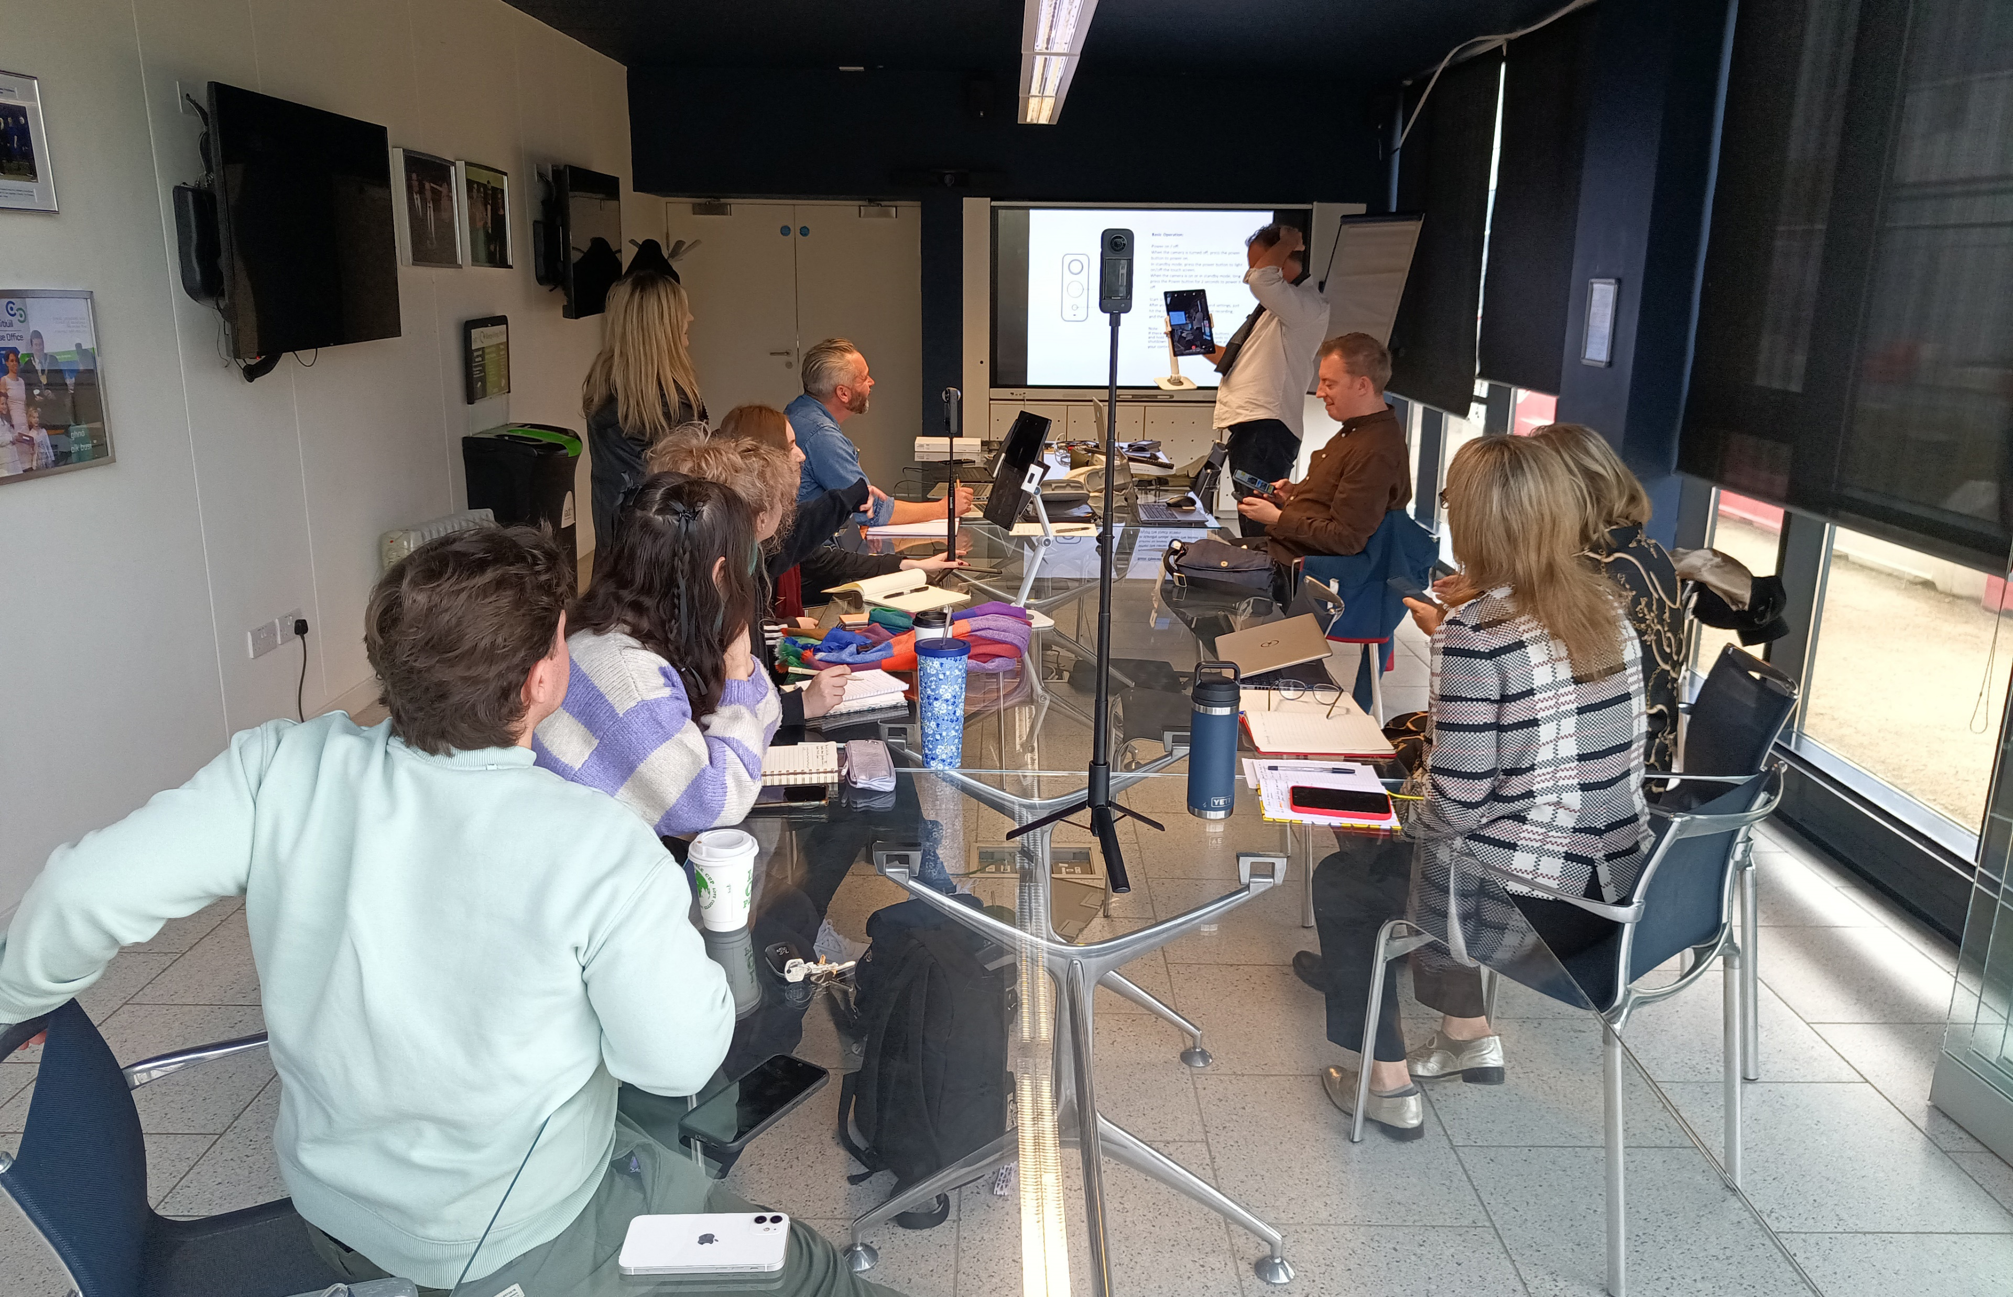
IADT’s Innovate Lab delivers structured workshops that facilitate the adoption of new technologies and ideas by industry and help deliver solutions to industry and societal challenges. A recent series focused upon immersive technologies.
Workshop 1: The Metaverse and How to Apply to Your own Practice
Workshop 2 : 360 Photography and Video
Workshop 3: Photogrammetry and Scanning
Attendees from
Creative Industries,
Education
Government or Non-Profit
Manufacturing and Engineering
Technology
“Really enjoyed the talk and it was great to use the platforms and understand more about the ecosystem and technology.”
Neil Leyden, Head of RTE.ie, Founder, Calico Media.

Slide 8
Collaboration In Action:
Strategic Partnerships

Slide 9

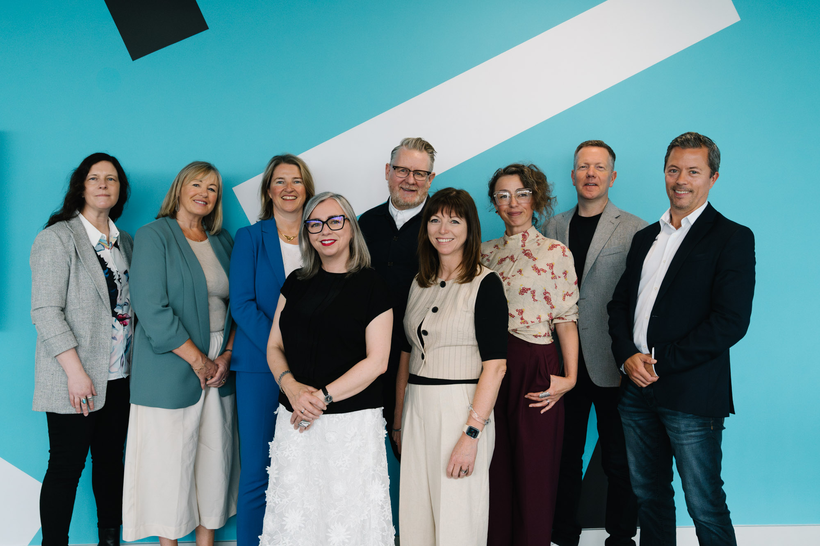
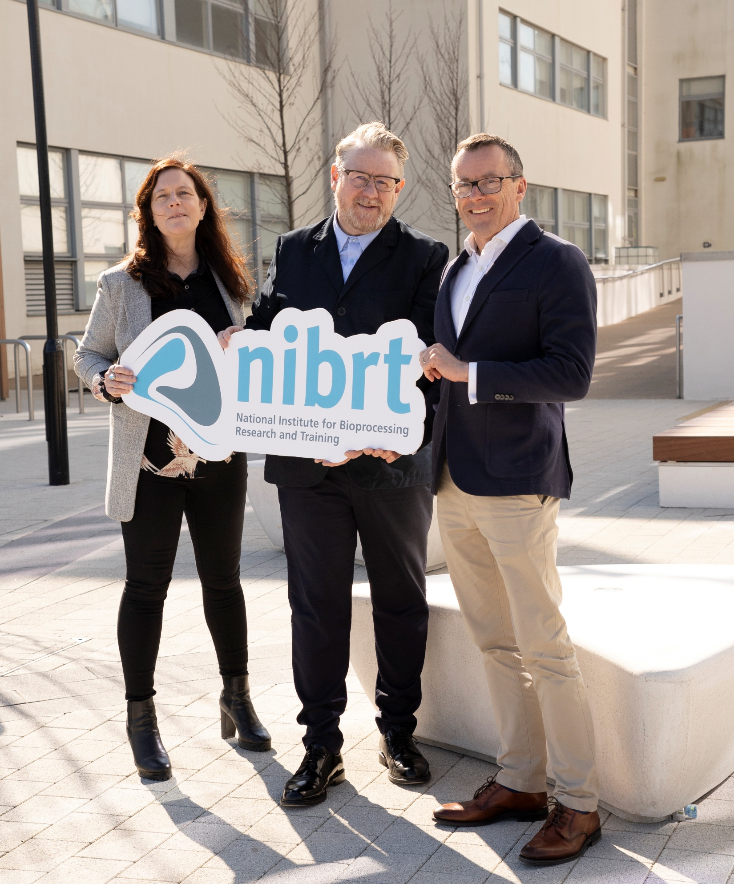
IADT x NIBRT
Jun 25
IADT & NIBRT commencing Cellular Encounters collaborative project
Joint submission by IADT and NIBRT researchers to Research Ireland New Foundations Programme
Aug 24
IADT Site Visit
to NIBRT
Dec 24
IADT & NIBRT MOU
Sept 24
NIBRT Site Visit to IADT
Jan 25
IADT partners with NIBRT on IMPACT funding proposal
May 25
Dr. Fiona Killard-Lynch, NIBRT, guest panelist at IADT Industry Day
NIBRT researchers attend SIT STAND SMOKE VR experience at IADT’s Immersive Studio

Slide 10
Benefits to NIBRT
Creative and Immersive Communication Capabilities
Access to IADT’s strengths in storytelling & immersive technologies - expanding NIBRT’s capacity to communicate complex biopharma research to diverse audiences.
Co-Creation of Public-Facing Research
Development of “Cellular Encounters”, a collaborative project blending creative practice with bioscience to make cellular and molecular research more accessible and engaging.
New Avenues for Dissemination and Public Engagement
Opportunities to prototype visual, spatial, and narrative interventions for public engagement, internal training, or stakeholder communication.
Engagement in Multidisciplinary Research
Participation in co-authored IMPACT funding proposals and creative research collaborations that complement NIBRT’s STEM expertise.
Benefits to IADT
Cross-Sectoral Research Development
Entry into the biopharma & life sciences ecosystem, enabling IADT to position creative practices as valuable contributors to STEM research impact.
New Models of Research Collaboration
Development of structured partnerships beyond the traditional creative industries, showcasing the transferability of IADT’s research methodologies.
Funded Collaborative Projects
Joint applications to competitive funding (e.g. IMPACT, New Foundations), and co-development of “Cellular Encounters” underpinned by an MoU.
Researcher and Staff Development
Opportunities for IADT researchers to work in interdisciplinary teams, enhancing skills in cross-sectoral engagement.
Institutional Profile and Strategic Alignment
High-profile collaboration supports IADT’s strategic ambition to be “Ireland’s university for the creative industries” and a national hub for creative research with societal impact.

Slide 11
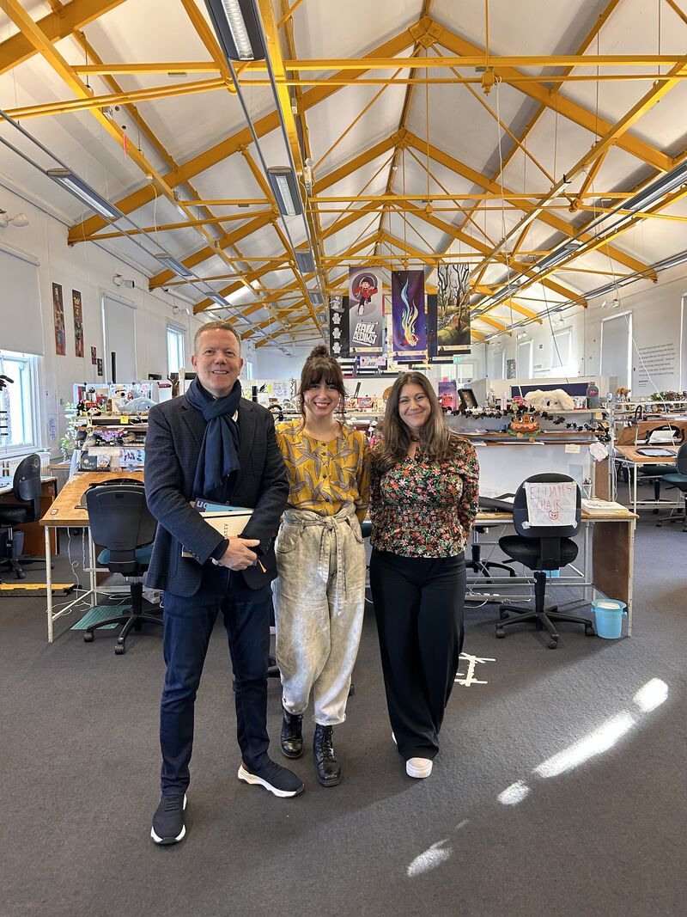
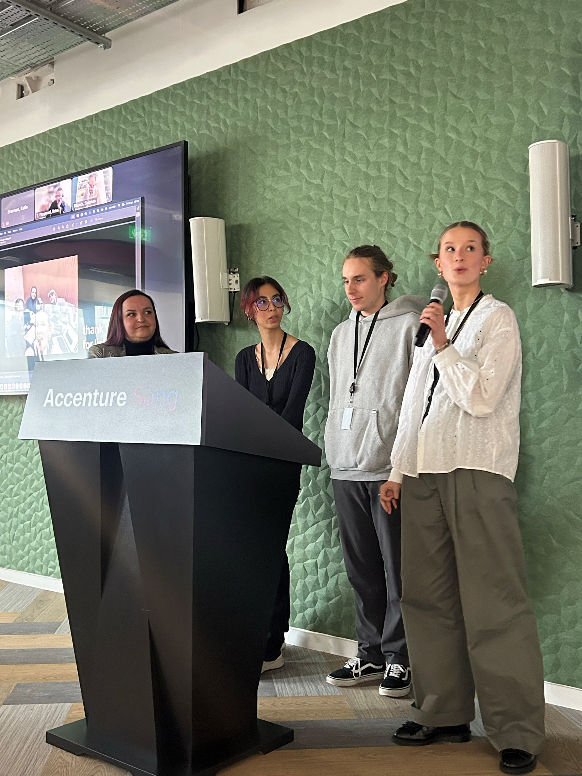
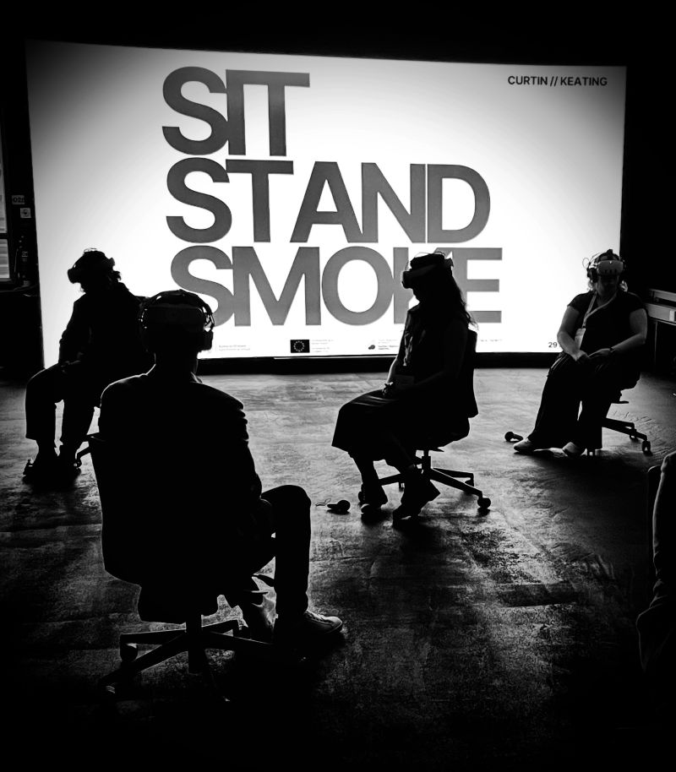
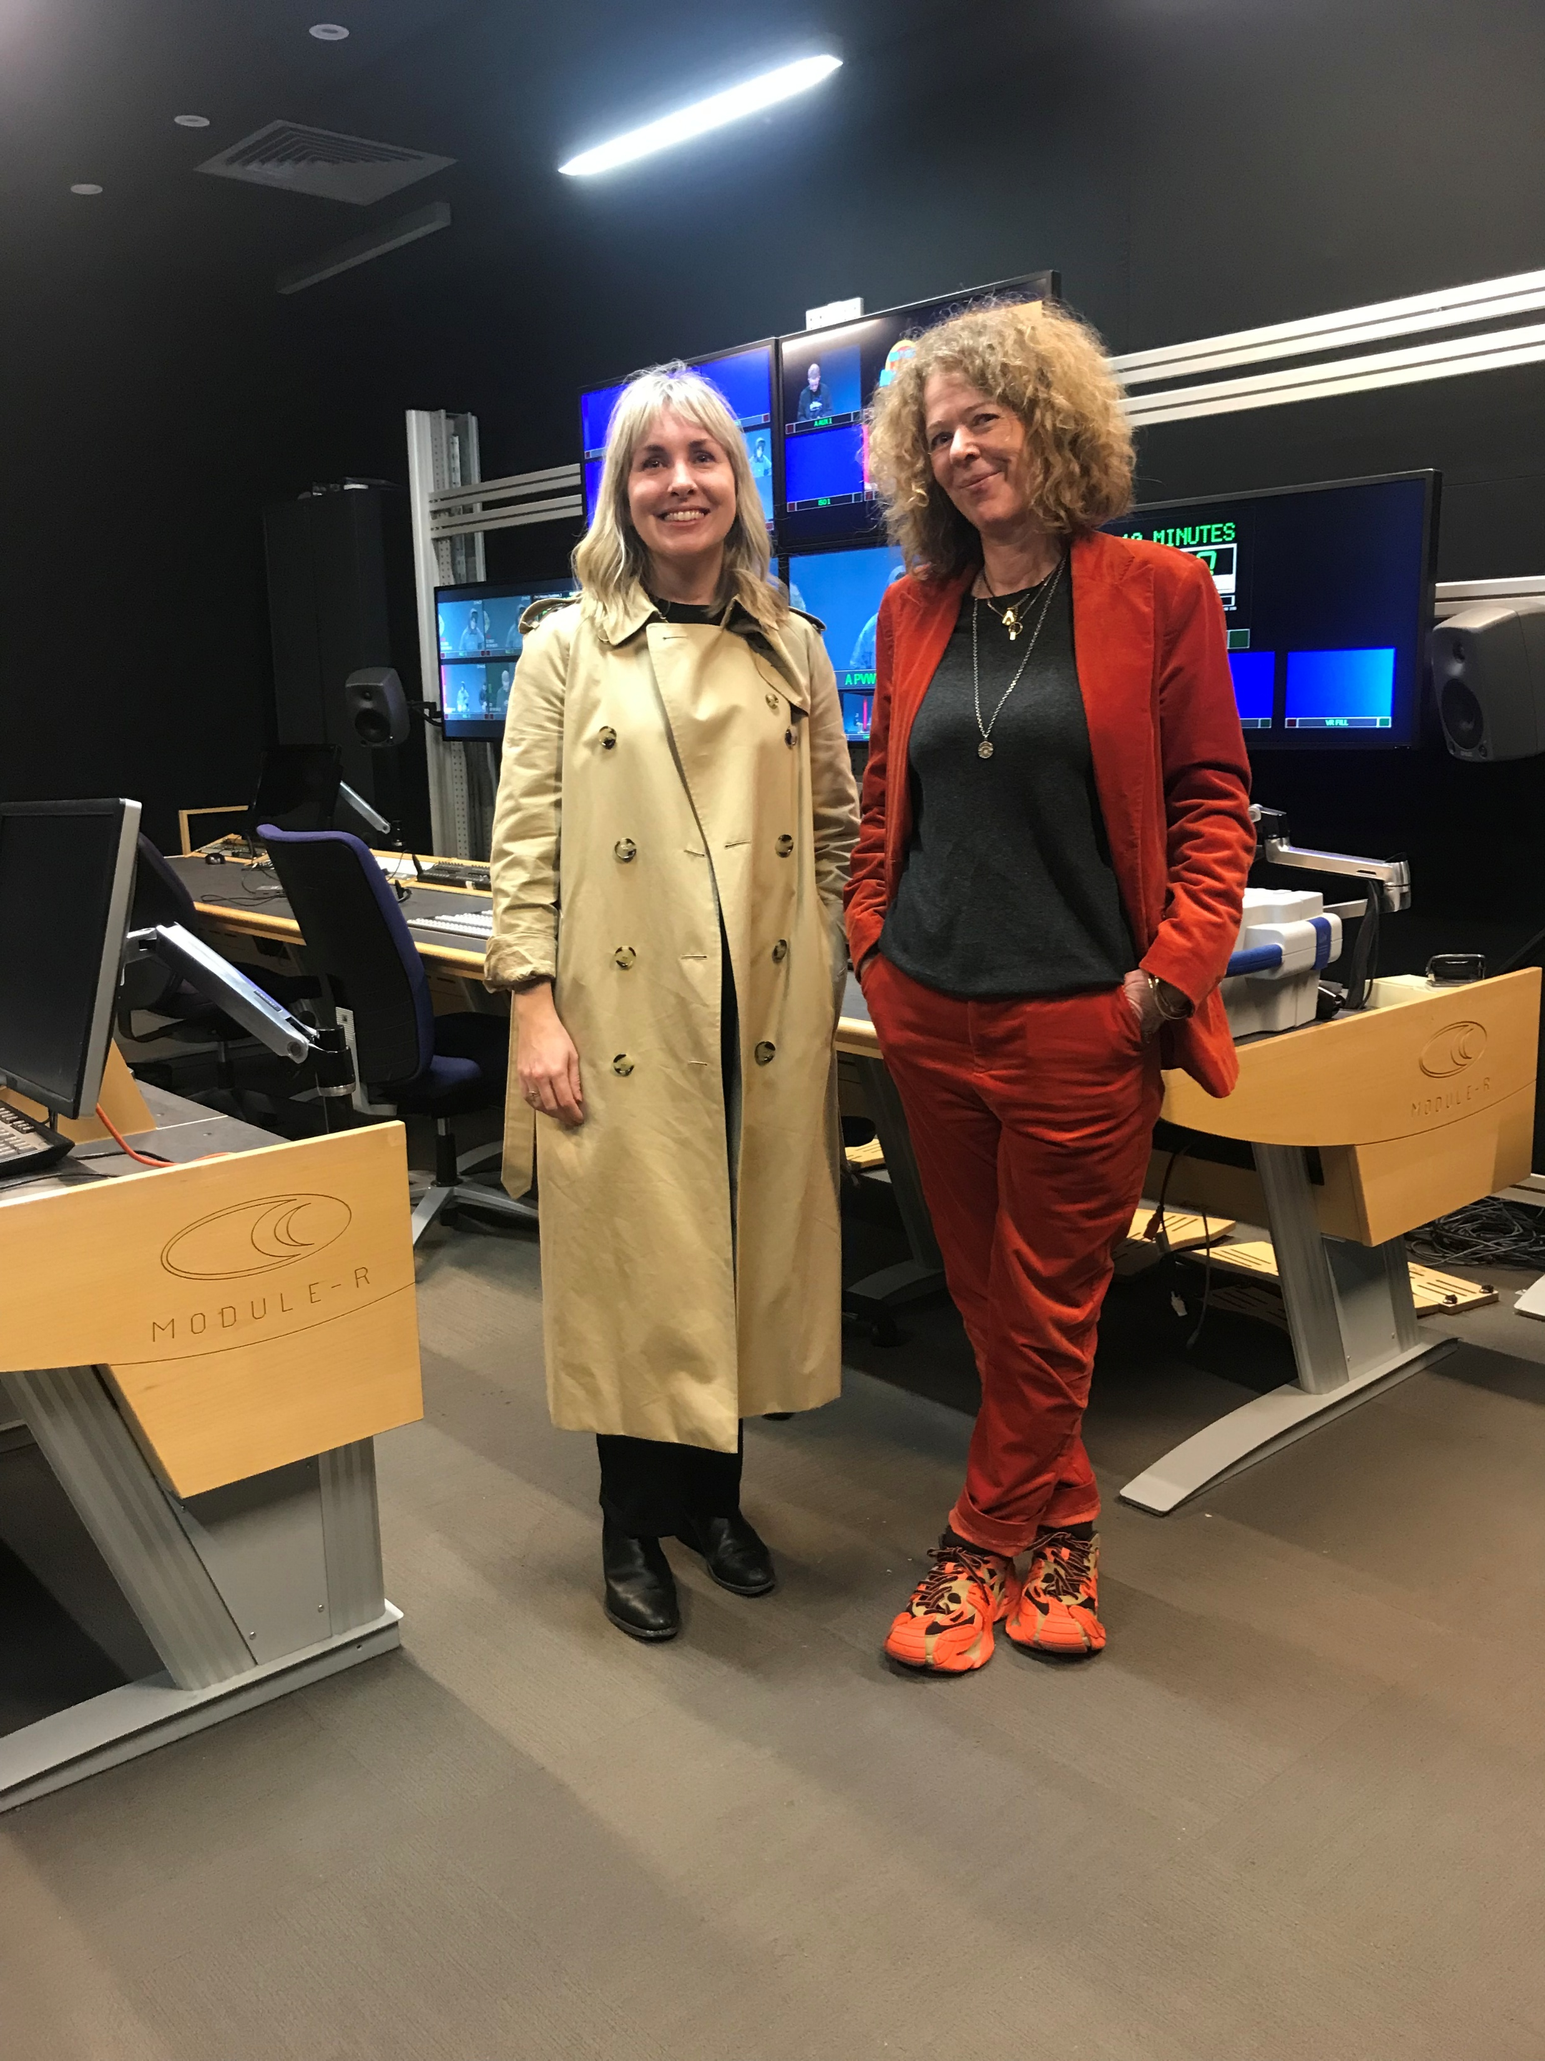
May 25
Accenture Song MD, Richard Carr guest panelist at IADT Industry Day
Head Of Production, Jessica Bermingham acts as expert industry consultant on IADT’s AI-AD Feasibility Study
Accenture Song team members attend SIT STAND SMOKE VR experience at IADT’s Immersive Studio
July 24
IADT Site Visit
to Accenture Song
Jan 25
Accenture Song Production visit to NFS
Oct 24
Accenture Song Site Visit to IADT
Apr 25
IADT Student Case Study Competition in Accenture Song
IADT x Accenture Song

Slide 12
Benefits to Accenture Song
Access to Creative Talent
Early engagement with IADT’s pipeline of creative graduates across design, film, immersive tech, and communications.
Collaboration on Emerging Technologies
Exposure to cutting-edge developments in AI, immersive media, and accessibility (e.g. contribution to AI-AD project, attendance at SIT STAND SMOKE VR experience at IADT’s Immersive Studio).
Brand Visibility and Thought Leadership
Featured on panels (e.g., IADT Industry Day 2025), enhancing visibility within the academic and creative innovation community.
Benefits to IADT
Deepened Industry Relationships
Multi-touchpoint engagement (site visits, guest lectures, project collaborations) supports IADT’s strategy of long-term, structured partnerships.
Enhanced Learning Experiences
Students engage directly with real-world briefs, boosting graduate employability and industry alignment.
Applied Research Collaboration
Opportunity to develop collaborative research and innovation
(e.g., through AI-AD feasibility study).
Profile and Credibility Building
Association with a global industry leader enhances IADT’s reputation as a go-to partner for the creative industries.

Slide 13
Our Research &
Innovation Infrastructure

Slide 14
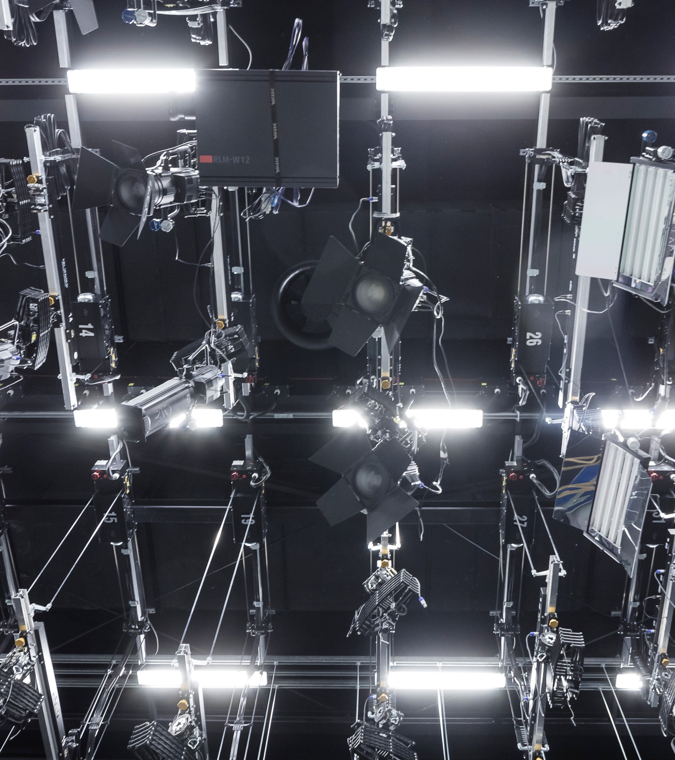
Our R&I Infrastructure Includes:
The Immersive Studio
Our new Immersive Studio includes a state of the art Virtual Production LED Wall and Motion Capture Suite. The Immersive Studio positions IADT as a leading innovator in immersive technology.
The National Film School
The National Film School features state-of-the-art facilities in film, television and radio production, design for stage and screen, and modelmaking.
Digital Media Building
This new four-storey facility contains 19 state-of-the-art digital design studios, advanced computer laboratories, seminar rooms and co-creation spaces.
Dolby Atmos Studio
Our audio SFX Room features a fully equipped 5.1 surround sound mixing environment, 7.1.4 Dolby Atmos suite, dedicated foley recording space, and a connected isolation booth for high-quality dialogue capture, providing an ideal setup for audio innovation.

Slide 15
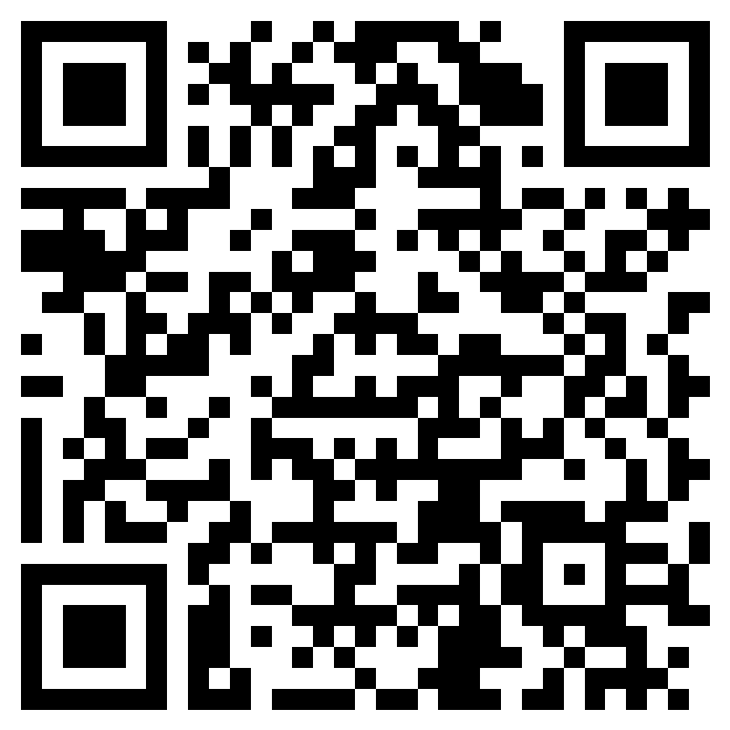
Thank you!
We’d love to explore how IADT can support your business through talent, innovation, and collaboration. This short form will take 2 minutes to complete.
michael.glennon@iadt.ie industry@iadt.ie

