Slide 1
Sandyford Business District SNG Meeting
Tuesday June 24th

Slide 2
Sandyford Business District
Building Global Connections:
European Association of Business Innovation Districts
SBD is actively working to establish connections with other EU business innovation districts to share common goals and best practices. Bringing aspirational Innovation Districts together to collaborate, share, learn and improve, presents the opportunity to build a community of premier Innovation Districts that will collectively respond to Draghi’s observations about Europe’s competitiveness challenges, and to ongoing global geopolitical upheaval.
As part of this initiative, we are delighted to welcome a European delegation on Monday, June 30th and Tuesday, July 1st for the launch of the new European Association of Business Innovation Districts, in partnership with Sandyford Business District.
This launch coincides with Ireland's Presidency of the Council of the EU—an ideal moment to raise visibility and momentum around this important topic.
During the event, we will also introduce the Manifesto for the European Association of Business Innovation Districts, outlining shared commitments and strategic objectives for the future.

Slide 3
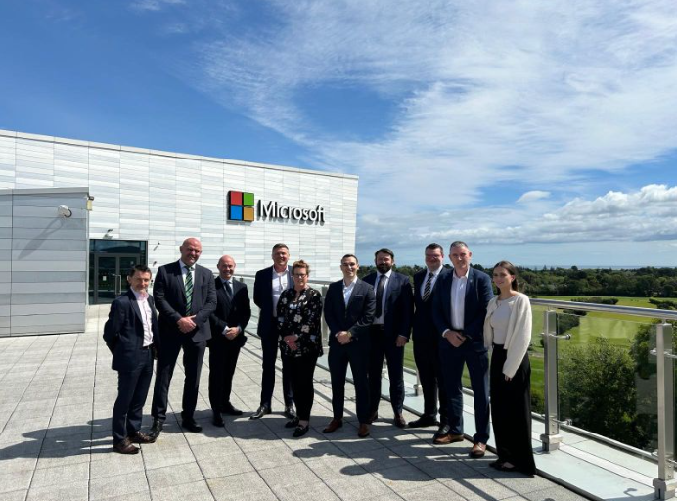
Sandyford Business District
Building Global Connections:
NYCEDC
On May 30th, SBD hosted a meeting at Microsoft with Daniel Clark, VP and Director of Business Development at the New York City Economic Development Corporation (NYCEDC).
Daniel Clark shared valuable insights and exciting opportunities for Irish businesses seeking to expand into New York City.
The session concluded with a roundtable discussion featuring local companies exploring international growth.

Slide 4
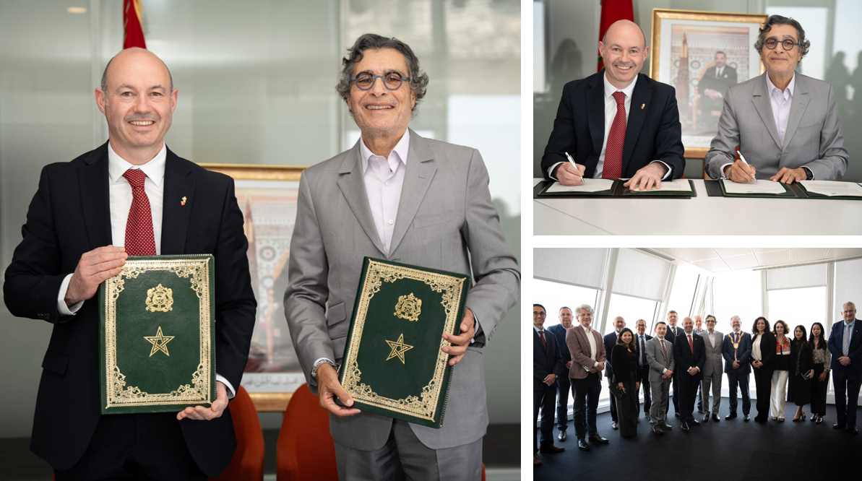
Sandyford Business District
Building Global Connections:
Trade Mission to Morocco
In April SBD, DLRCC (An Cathaoirleach Cllr Jim O’Leary & CEO Frank Curran), and local business leaders visited Morocco.
SBD signed an MOU with Casablanca Finance City (CFC), supported by CFC and the Irish Embassy.
Hosted by the Mayor of Casablanca, Nabila Rmili
Emerging collaboration opportunities in: Fintech, Tourism, Construction, Agritech, and Erasmus mobility.
Open to further engagement

Slide 5
Sandyford Business District
Building Local Connections:
Additional MOUs
SBD has also recently signed MOUs to foster collaboration on research, innovation, skills development, and strategic initiatives
Institute of Art ,Design and Technology (IADT)
Irish Management Institute (IMI)

Slide 6
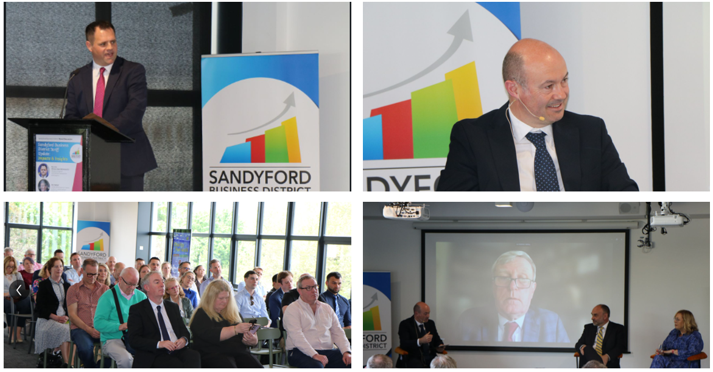
SBD Tariff Briefing:
Impacts & Insights for Sandyford Businesses
On May 1st SBD hosted an exclusive briefing for local business leaders on the implications of U.S. tariffs for Irish businesses. Minister Neale Richmond TD delivered the keynote, with expert insights from Daniel Mulhall, Carol Boyne Lynch, and Terence Deacon

Slide 7
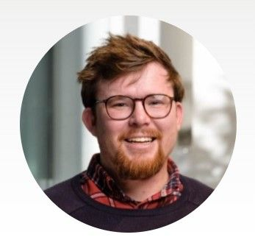
New Sustainability Advisor Joins SBD
Dr. Aodhan Newsholme appointed as consultant & advisor on the circular economy
Lecturer at Munster Technological University & member of IKC3 (Ireland's Knowledge Centre for Carbon, Climate & Community Action)
Brings expertise in academic research & global supply chain management
Voluntary role to guide sustainability initiatives in Sandyford Business District (SBD)
Focus areas include integrating circular economy principles & supporting projects like Circular-PSP
Key to advancing carbon reduction, biodiversity enhancement & SBD’s sustainable transformation

Slide 8
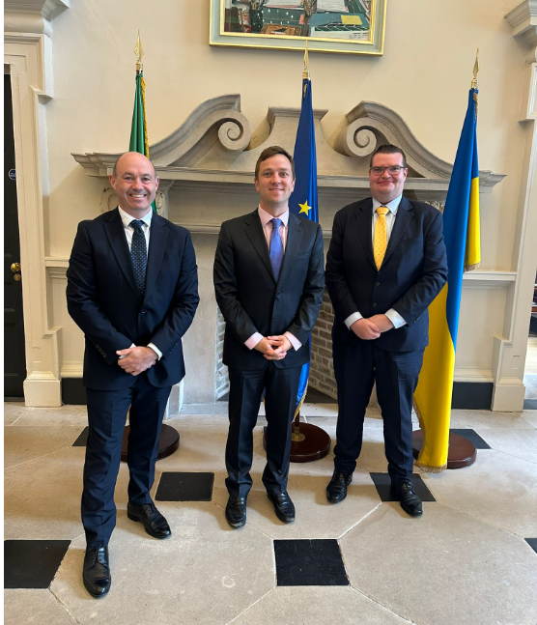
SBD Meets Deputy James Geoghegan
to Discuss Investment and Safety Priorities
On May 26th we met Deputy James Geoghegan at Leinster House to discuss The District’s priorities, including investment, economic growth, and improving safety and public confidence in Dublin, with a view to ongoing collaboration.

Slide 9
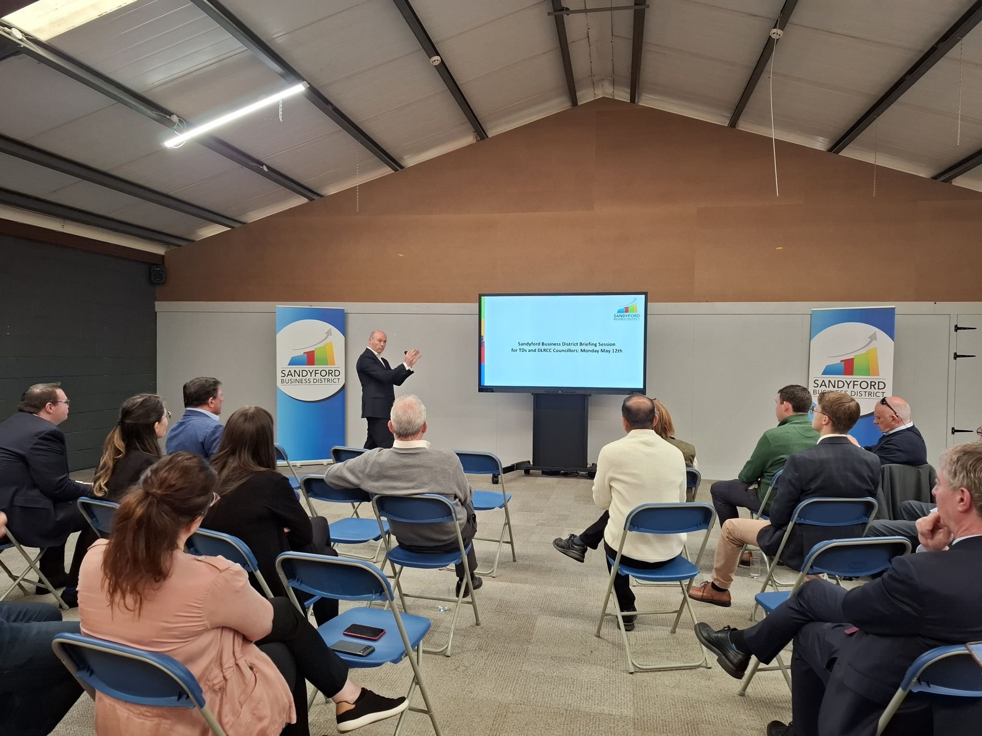
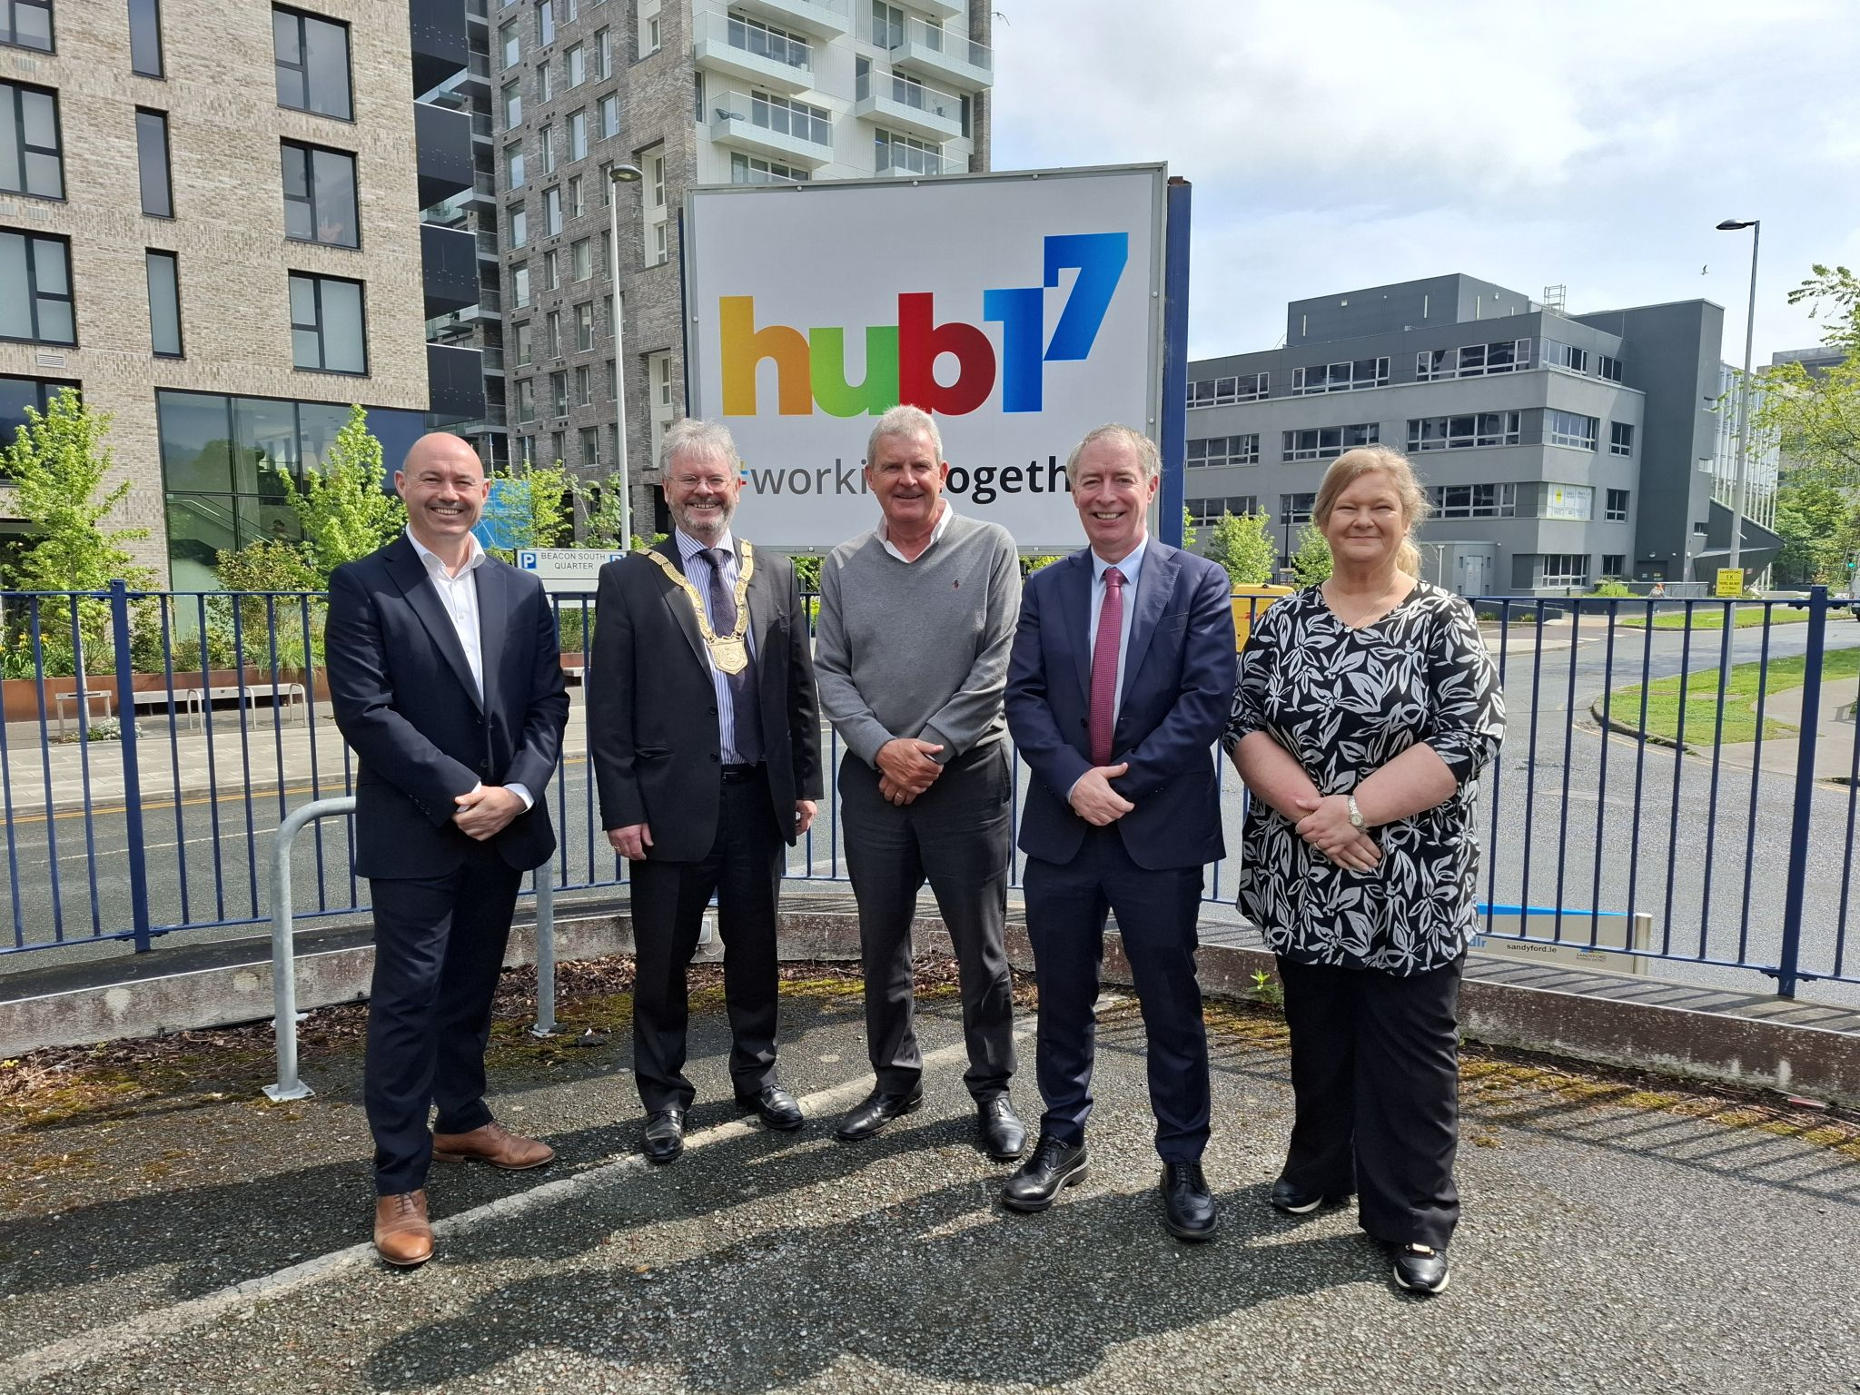
SBD Briefing Session for TD and Councillors
On May 12th We hosted another engaging briefing session for TDs and DLRCC Councillors.
At the meeting we provided key updates and insights on our recent activities and priorities for The District and stressed the importance of continued collaboration and the focus on strategic priorities:
• Sandyford Urban Framework Plan
• A community centre located in Sandyford Business District - Imaginosity
• Public access to the Stillorgan Reservoir
• Junction 14 and Cycle Lanes

Slide 10
SBD Annual Wellness Week:
May 6th to 9th
Event Highlights:
Sandyford 5K (over 1,000 participants)
7-a-Side Soccer Competition (10 teams) – Winners were RBK
NEW! Sandyford’s Fittest Company Competition (12 teams) – Winners were Echelon Data Centres
Free Gym & Fitness Sessions
Health & Beauty Offers
Live Music

Slide 11
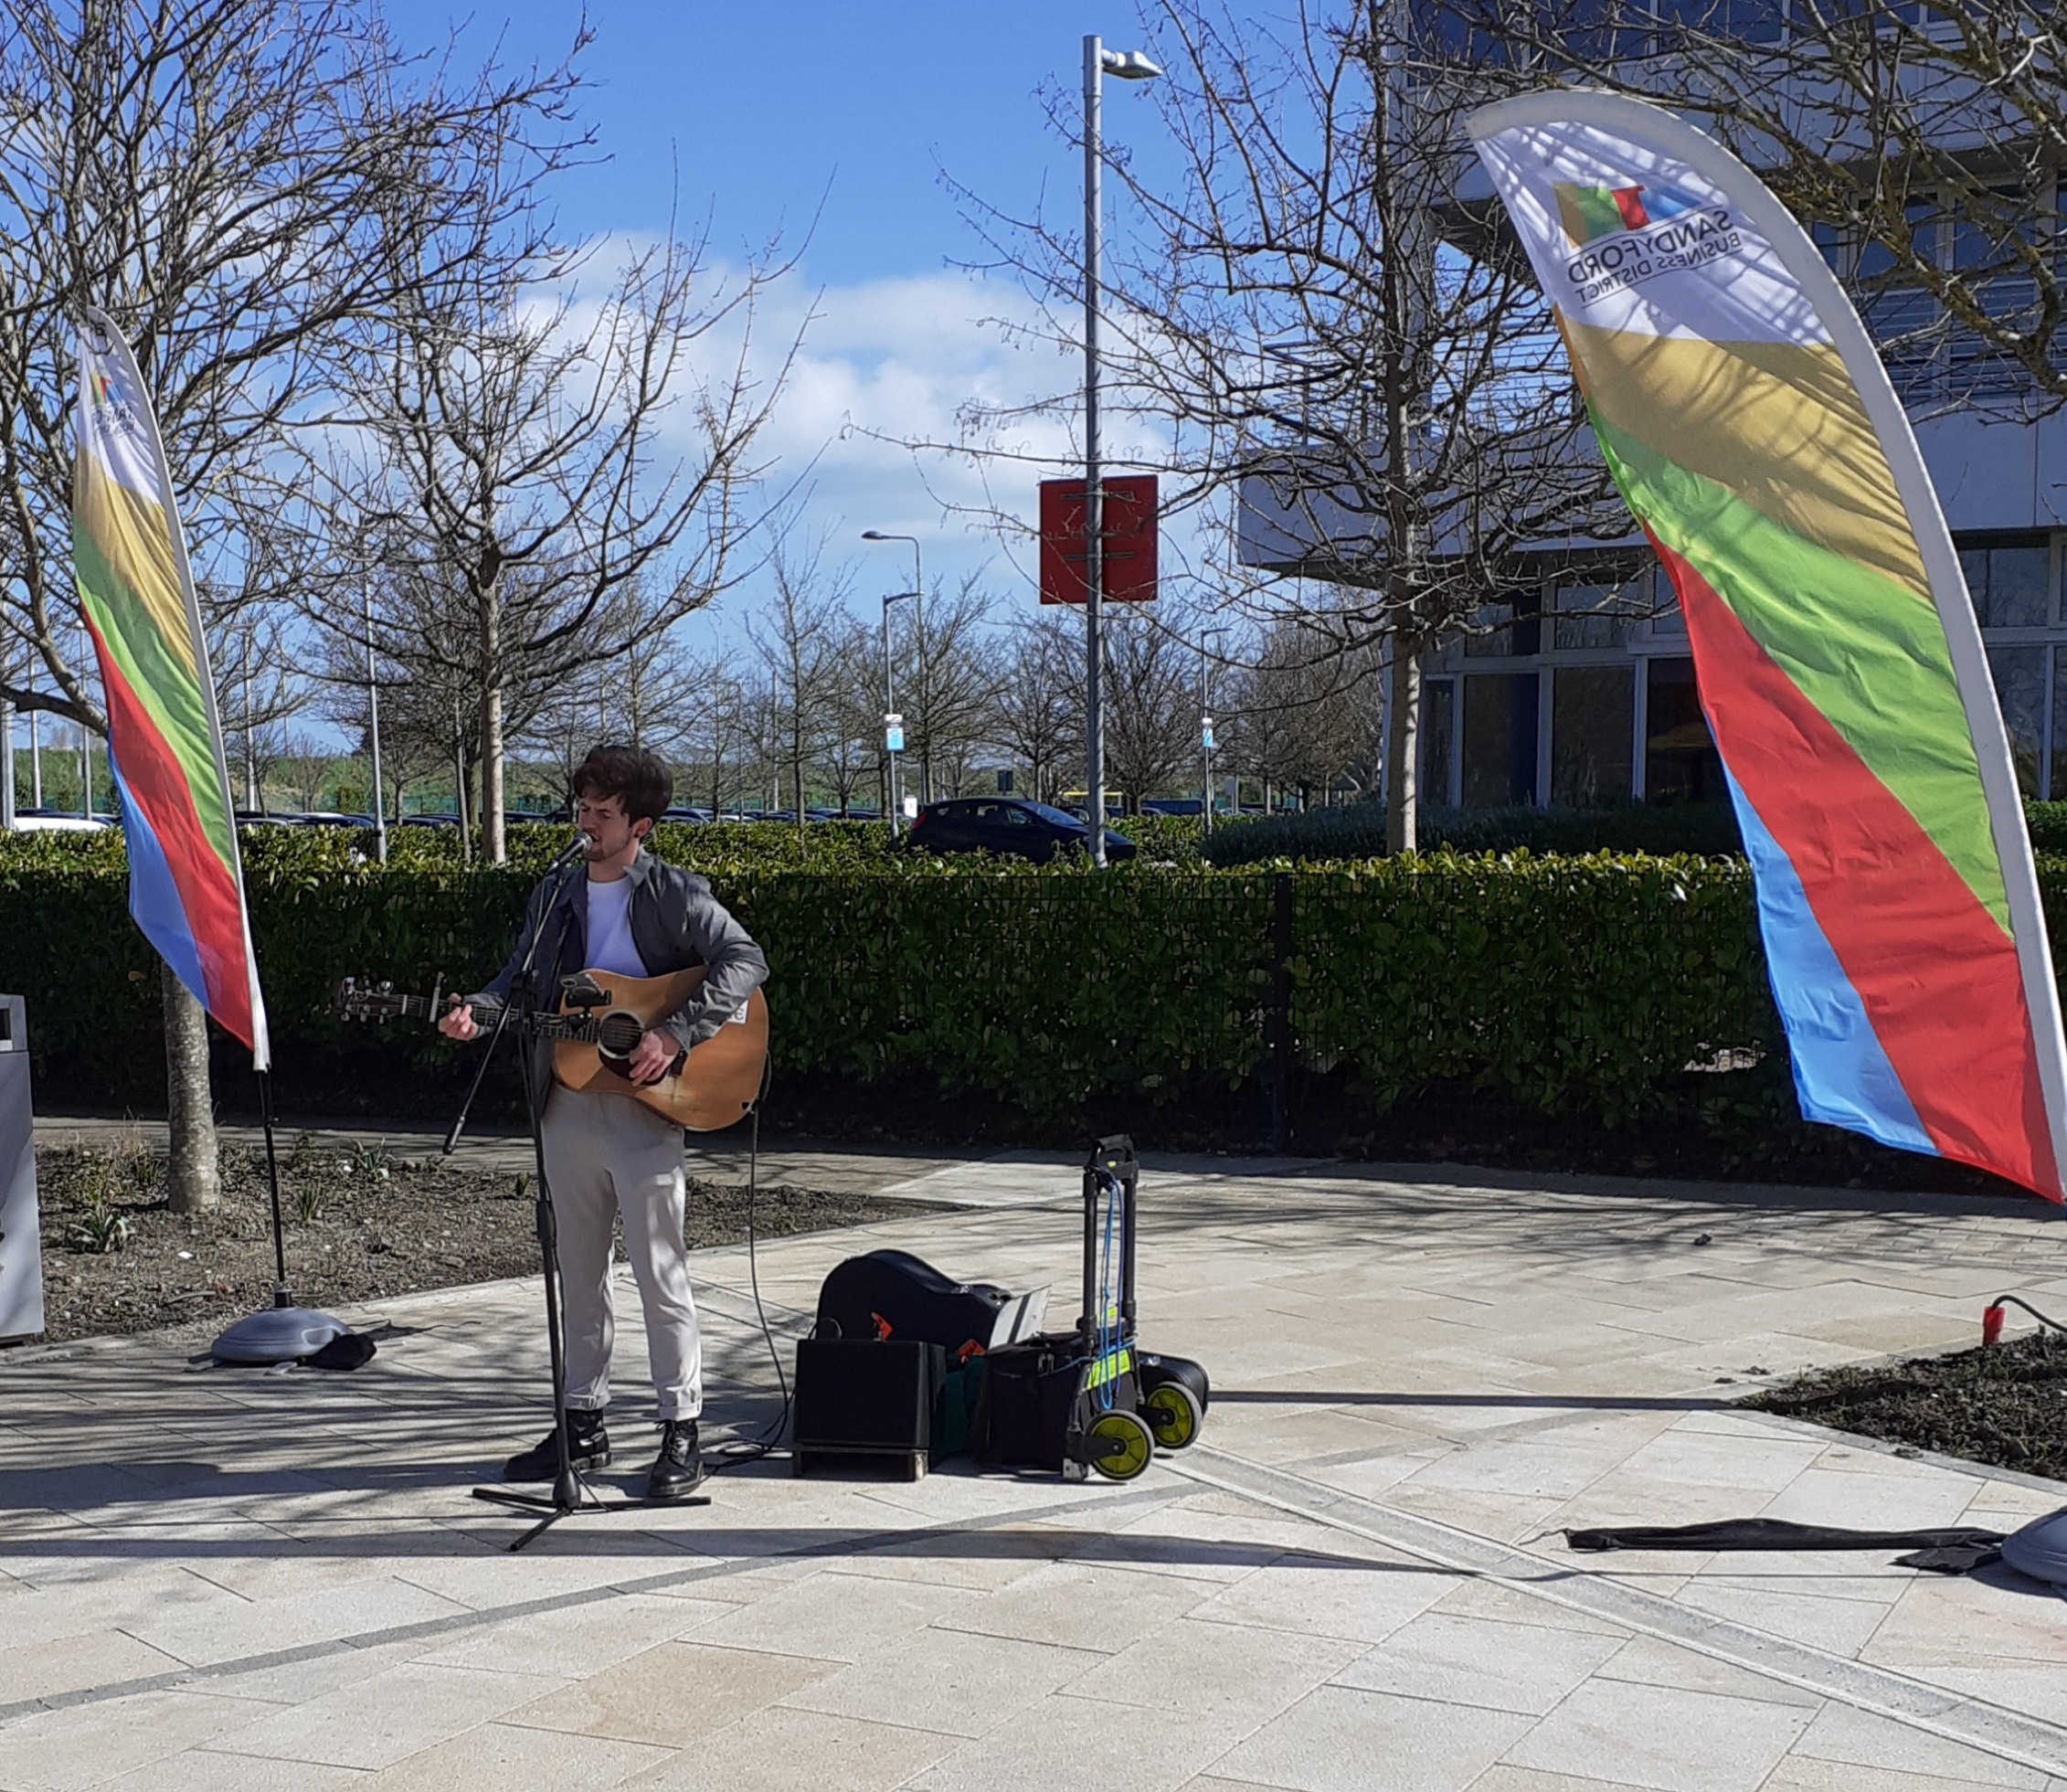
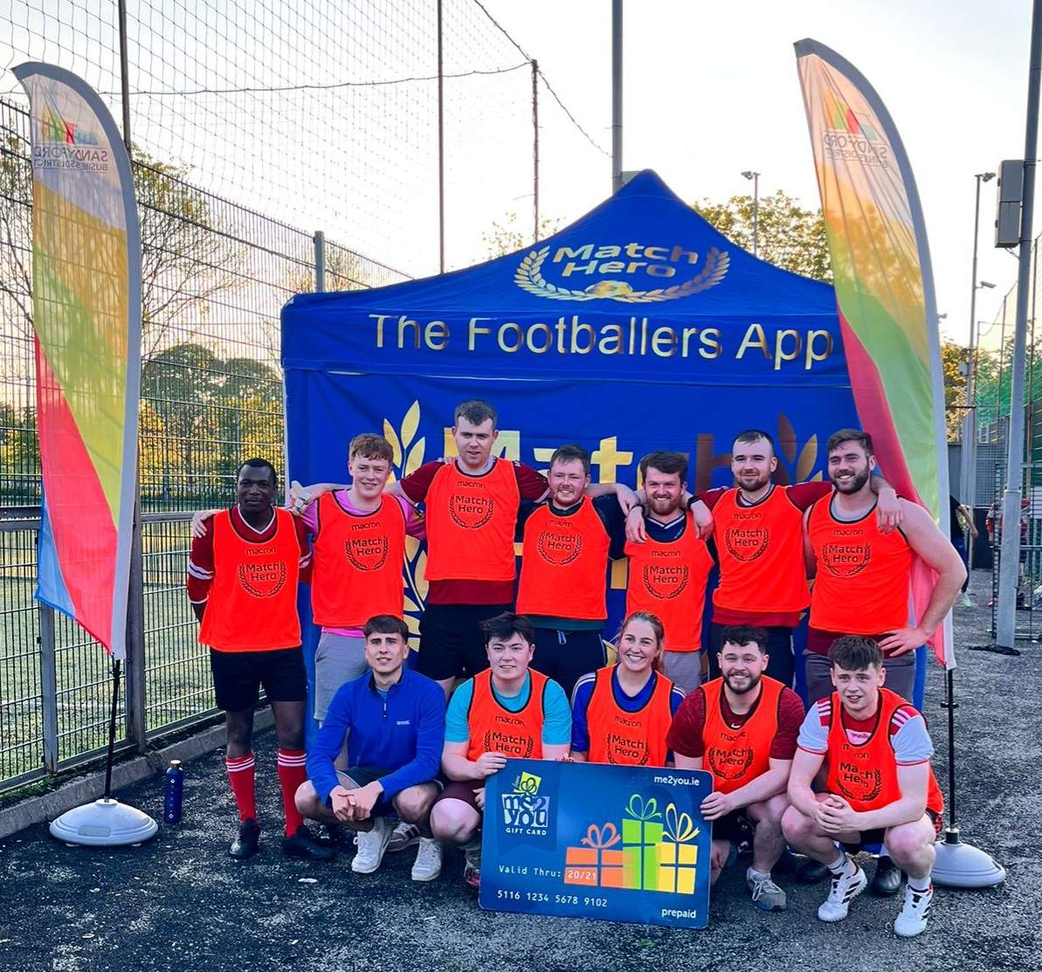
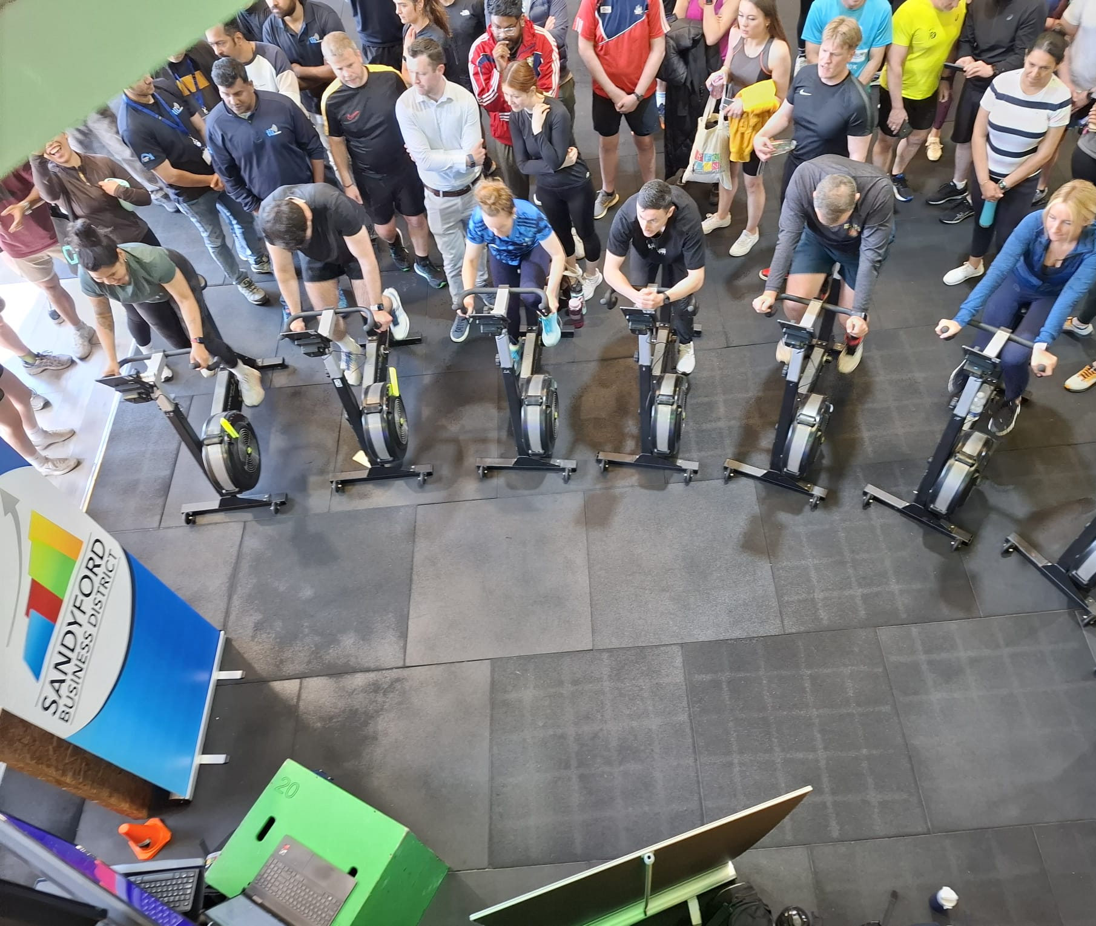
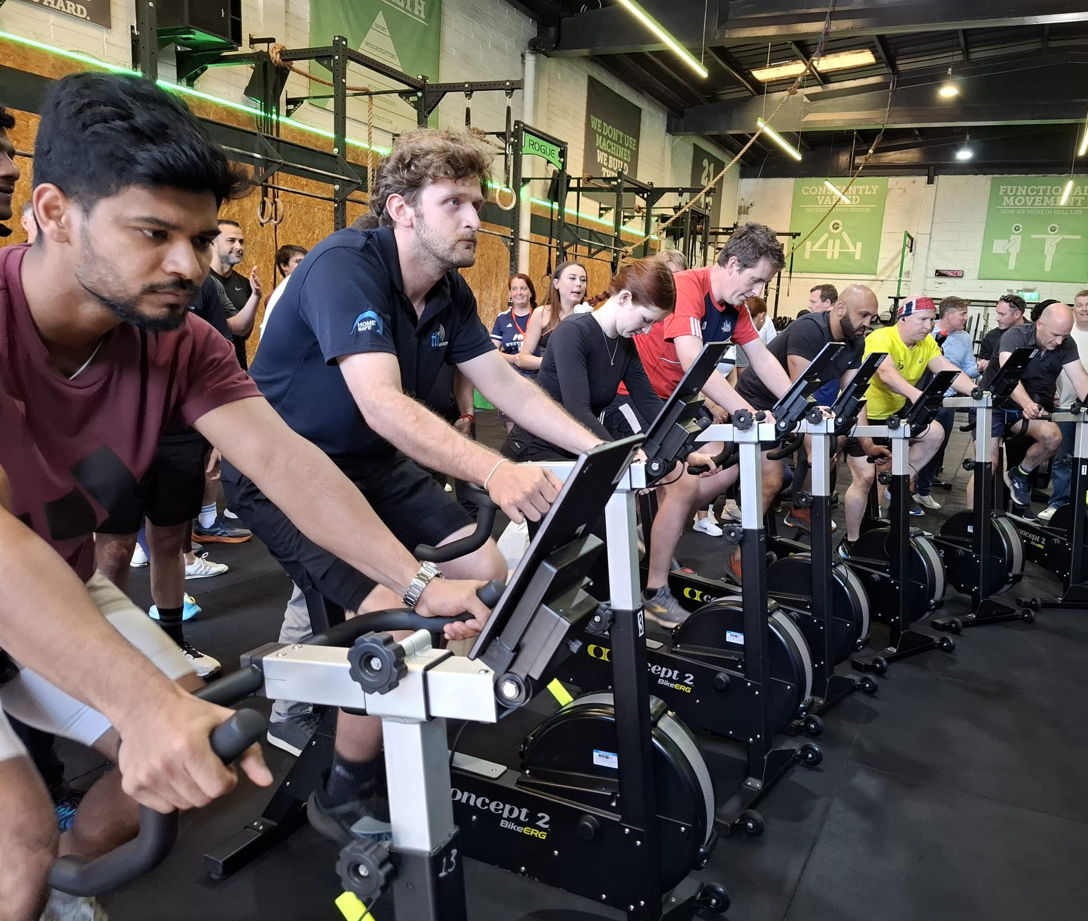
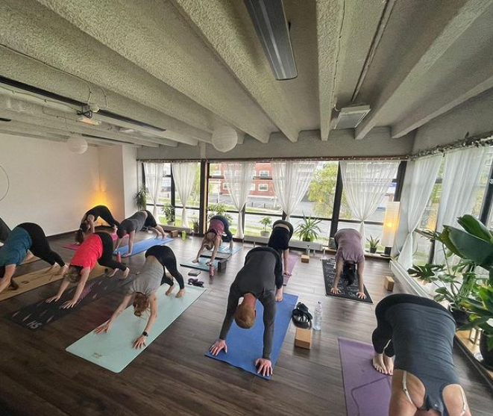
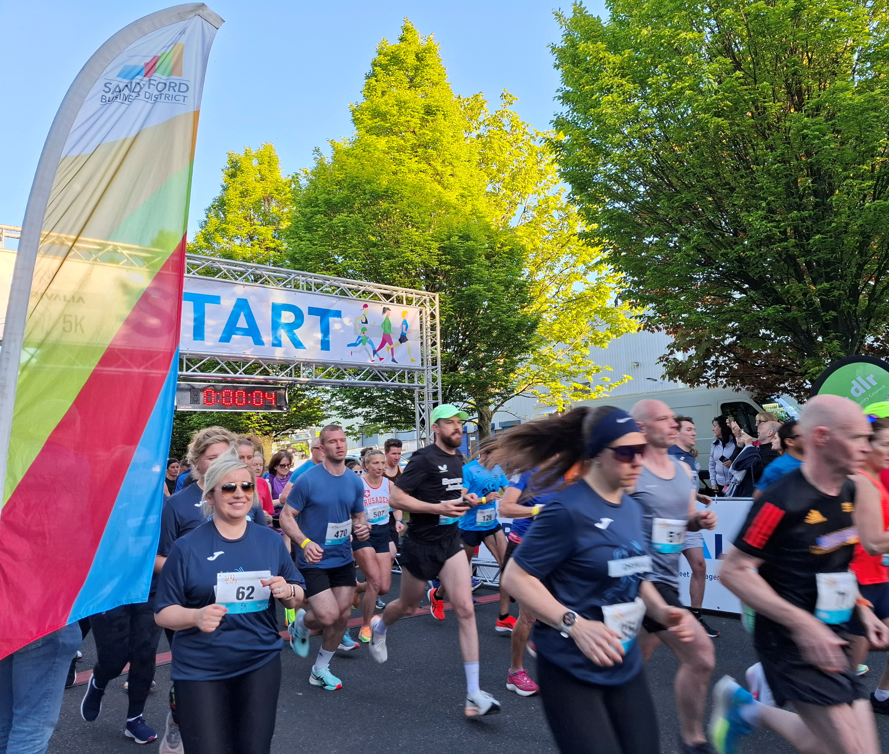

Slide 12
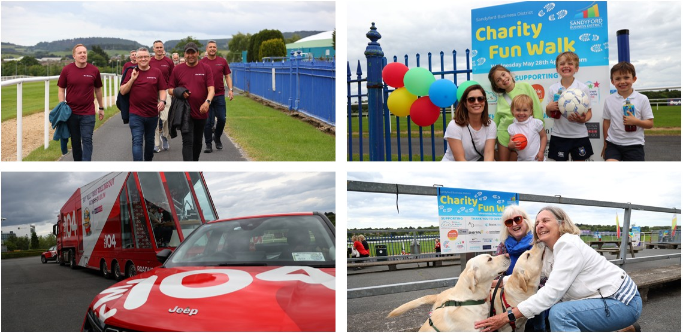
SBD Charity Fun Walk:
Leopardstown Racecourse May 28th 4-7PM
On Wednesday May 28th we welcomed families and employees from across The District—and beyond—to our Charity Fun Walk in support of four incredible local charities all based here in The District:
Children in Hospital Ireland
The Down Syndrome Centre
Changing Lives DLR
Enable Ireland
Thank you to everyone who turned up to take part in
the walk and thanks to the many companies whose
generous support made the event possible

Slide 13
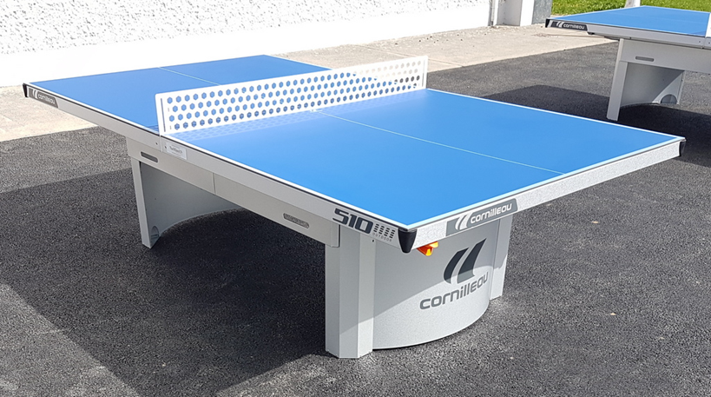
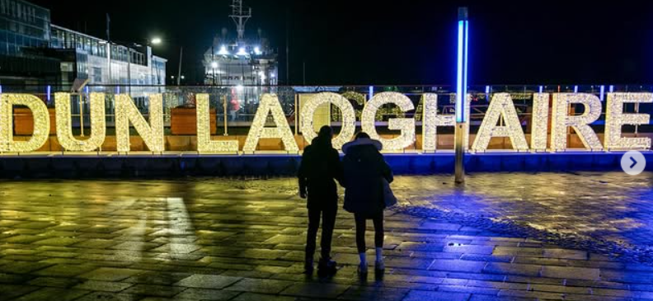
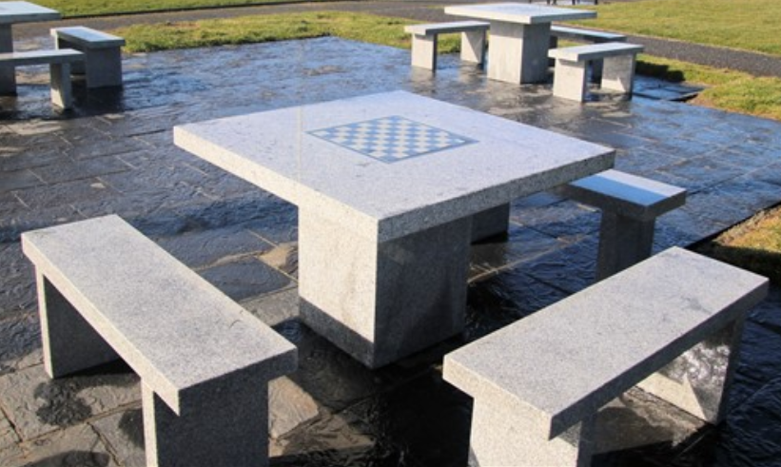
SBD Placemaking:
A number of Initiatives coming soon
Table Tennis Tables in Overend and Bracken Road Pocket Parks
Chess Tables in Overend and Bracken Road Pocket Parks
Sandyford 3D Lettering across from Stillorgan Luas stop

Slide 14
Work a Day in My Shoes
Spending a day alongside businesses across The District to gain first-hand insight into their daily challenges and opportunities.

Slide 15
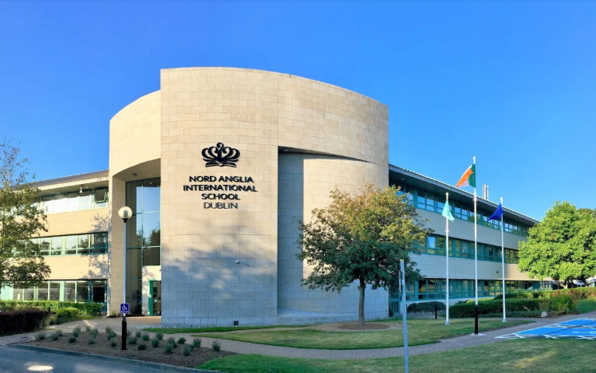
NAIS is looking for Student Travel Assistants
Help Keep Students Safe on Their Journey
Nord Anglia International School is seeking responsible Student Travel Assistants (Bus Monitors) to accompany students to and from their campus in South County Business Park, ensuring all travel safety procedures are followed.
This role is ideal for individuals who regularly commute from the following areas:
Morning Pick-Up Locations: • Ballsbridge – Fitzwilliam Square (approx. 7:15 am) • Rathmines – Bushy Park House (approx. 7:15 am) • Dalkey – Park Pointe Shopping Centre (approx. 7:20 am)
Students arrive at school by 8:00 am. Buses depart the school at 3:30 pm and 4:30 pm for return journeys.
All successful candidates will be Garda vetted.

Slide 16
Any Questions for the SBD Team?

