Slide 1


Sandyford Business District
Strategic Network Group Meeting
Wednesday September 3rd
In collaboration with Polestar Dublin

Slide 2
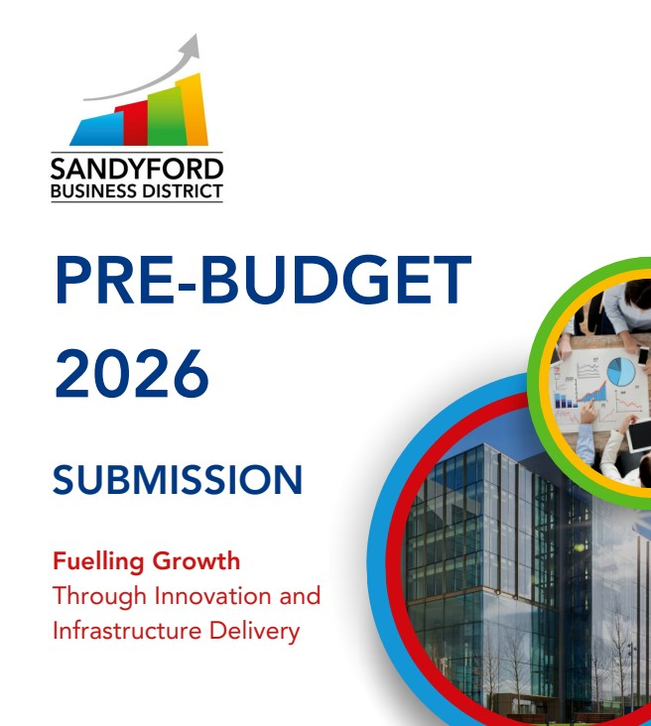
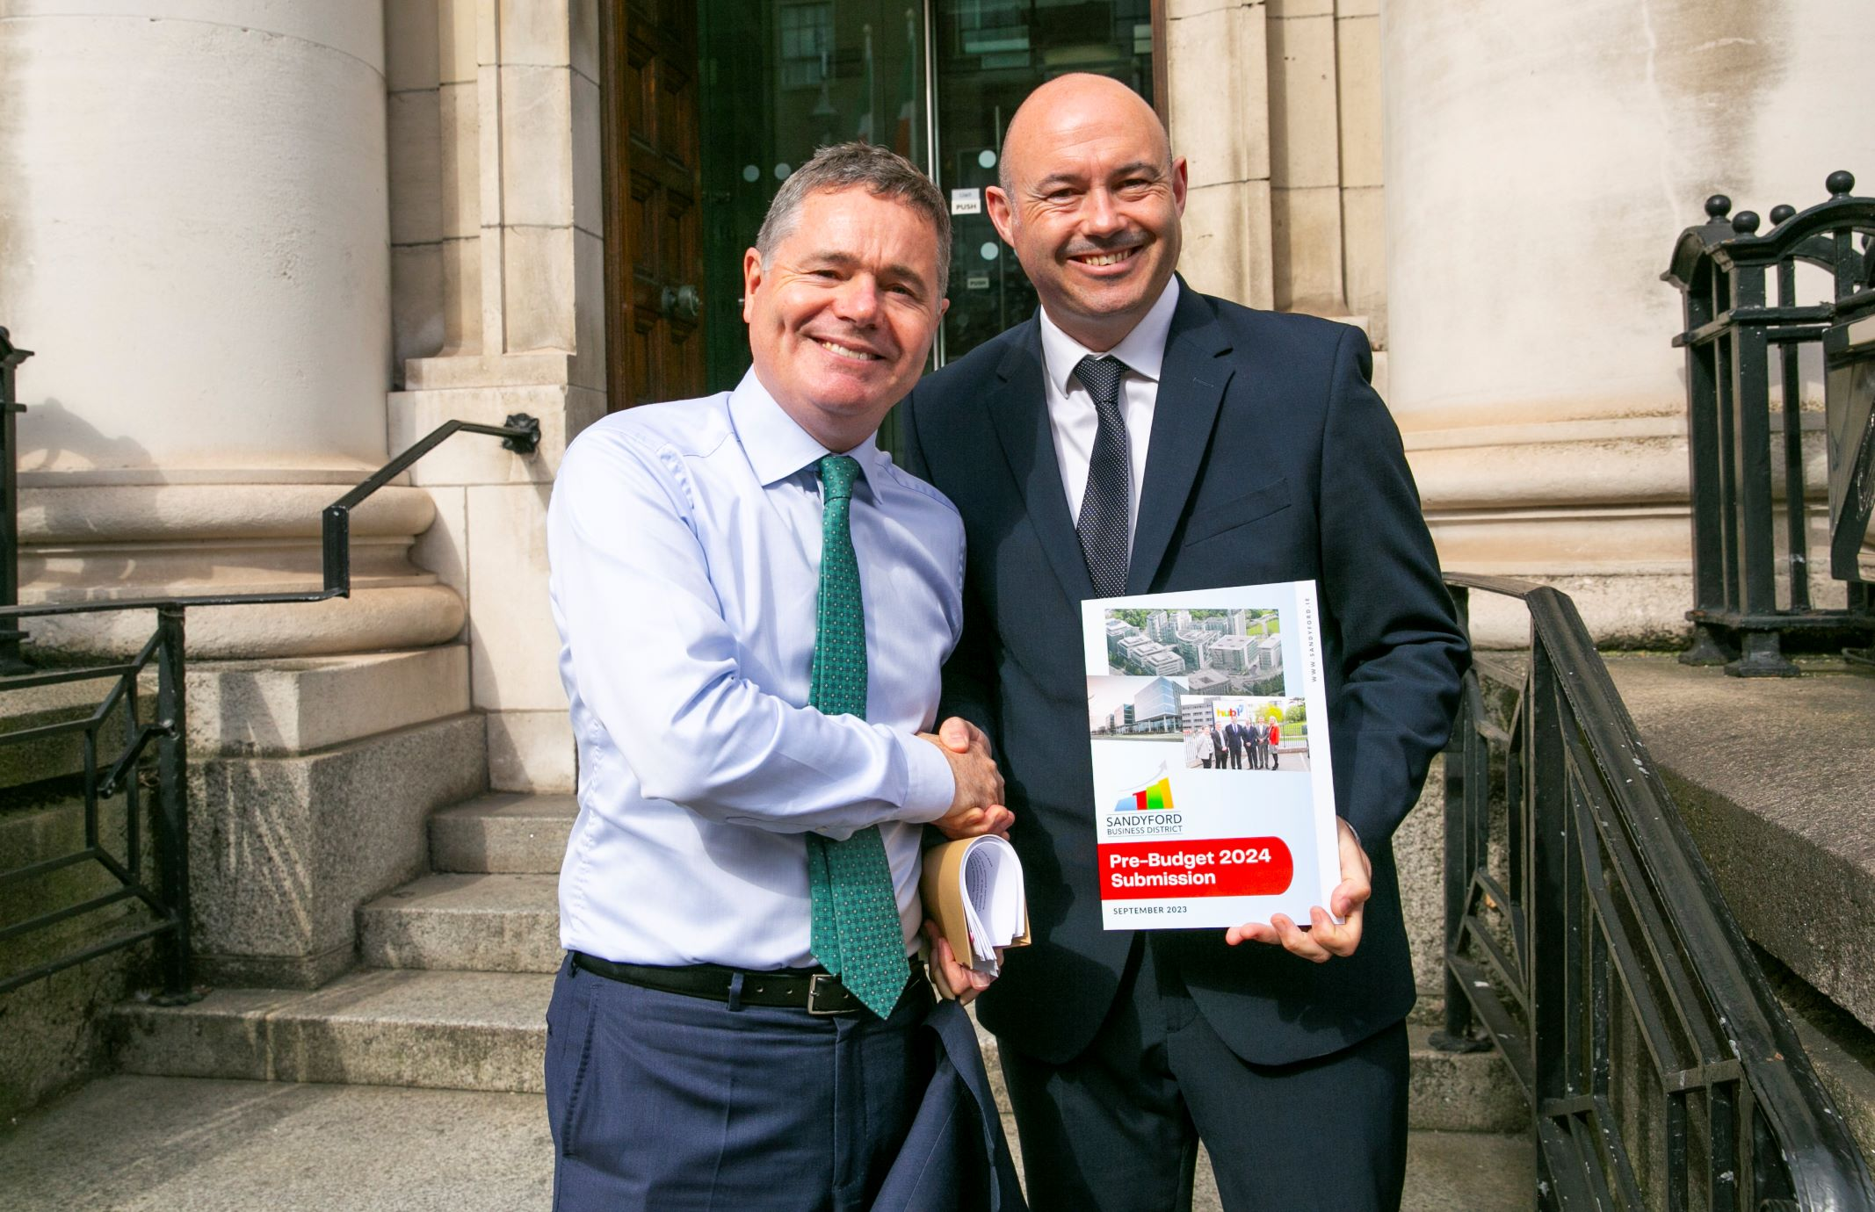
SBD Pre-Budget 2026 Submission
As part of our ongoing commitment to representing the needs of over 1,000 companies and
30,000 employees, Sandyford Business District has submitted proposals for Budget 2026.
Our submission calls on Government to take decisive action to safeguard Ireland’s competitiveness and support long-term, sustainable economic growth.
For Budget 2026, we are advocating investment in the following strategic areas:
Fostering start-up growth through incubation and innovation hubs
Developing housing to attract and retain a high-skilled workforce
Investing in critical transport and infrastructure to support sustainable growth
Reducing business costs to enhance competitiveness
To read the full submission
go to www.Sandyford.ie

Slide 3

SBD SUFP Submission
SBD made a formal submission to Dún Laoghaire–Rathdown County Council as part of the SUFP review
The process will guide the future development of The District – ensuring it remains vibrant, competitive & sustainable
Submission prepared by John Spain Associates (Planning & Development Consultants)
Focus areas: infrastructure, transport, housing, placemaking
To read the full submission
go to www.Sandyford.ie

Slide 4
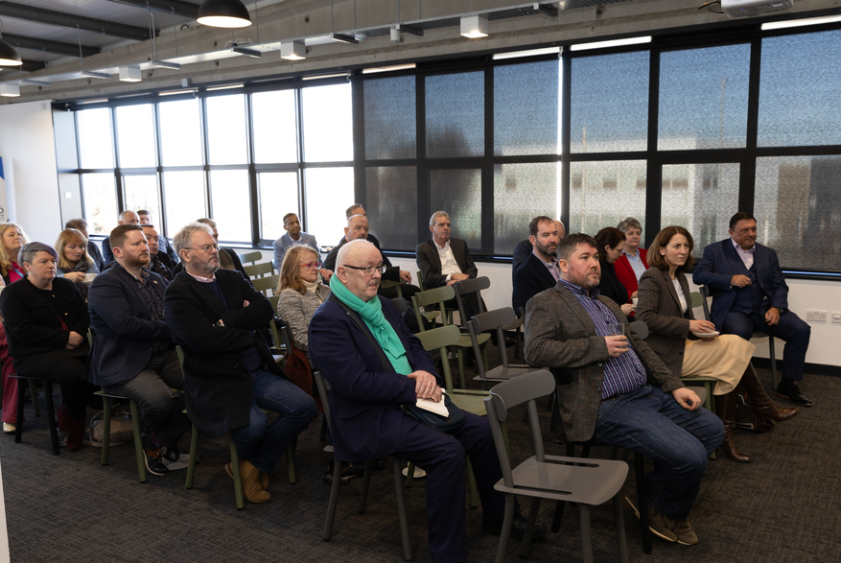
SBD Briefing Session for TD and Councillors
Next Monday – September 8th we will host our 3rd briefing session for TDs and
DLRCC Councillors.
At this meeting, we will:
Discuss key priorities for The District
Emphasise the importance of continued collaboration
Reaffirm our focus on strategic priorities
  Development of a community centre in Sandyford Business District (Imaginosity site)
  Ensuring public access to the Stillorgan Reservoir
  Improvements at Junction 14 and expansion of Cycle Lanes
If there is anything you would like us to raise on your behalf
please let me or one of the team know today
or email operations@sandyford.ie

Slide 5
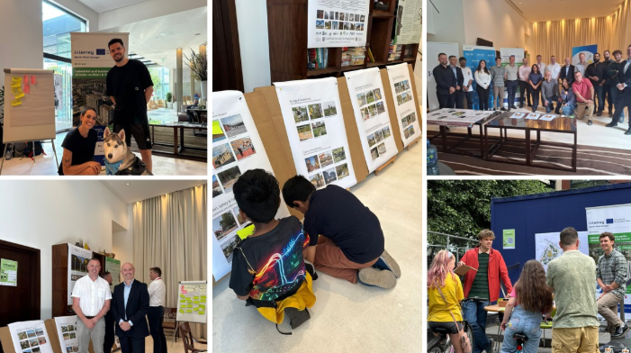
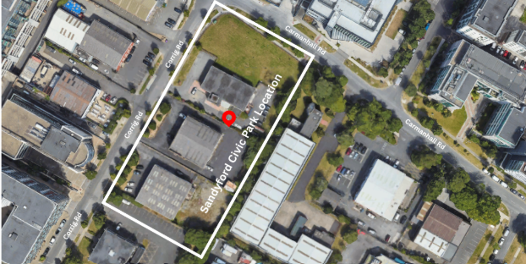
SBD Civic Park
Collaboration between Sandyford Business District & DLRCC
Transforming 0.8 hectares at Corrig Rd & Carmanhall Rd into a multi-use green space
Vision: a dynamic civic space for events, activities & everyday enjoyment
Survey closed on August 6th – capturing community views & aspirations
Responses will help shape a park that meets the needs of residents, businesses & visitors

Slide 6
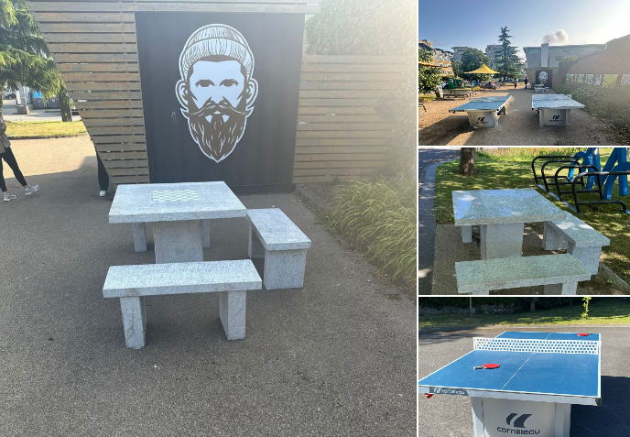
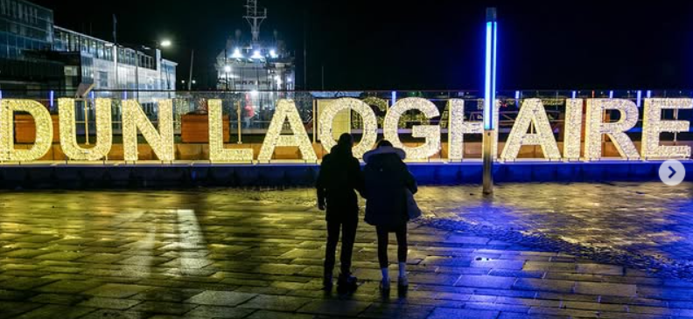
SBD Placemaking: Recently Installed Initiatives
Table Tennis Tables in Overend and Bracken Road Pocket Parks
Chess Tables in Overend and Bracken Road Pocket Parks
Coming soon Sandyford 3D Lettering across from Stillorgan Luas stop

Slide 7
Sandyford Business District Plebiscite 2026
What is Sandyford BID?
  Business-led initiative funded by a levy on local ratepayers.
  Established in 2017 after 82% of businesses voted in favour.
  Renewal plebiscites held every 5 years – next one is 2026
Why it matters: What happens if SBD is not re elected?
  Loss of added Value:
  No dedicated funding for public realm & placemaking projects
  Marketing, events & business supports discontinued
  Sustainability & smart district initiatives halted
  SBD has built a strong, trusted relationship with Dún Laoghaire-Rathdown County Council over many years – a collective voice individual businesses would lose without the BID
✅ We Need Your Support!!
Please provide the correct contact person in your company.
This should be the individual who authorises the annual BID levy.
The ballot paper will be sent to them, and we want to ensure they understand its importance.

Slide 8
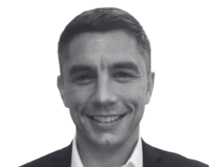
SBD New Engagement Manager
Welcome Alan Shortt – New Engagement Manager
SBD’s mission: create a thriving, connected, dynamic environment to work, live & visit
Engagement Manager role: key to bringing this vision to life
Alan will:
  Collaborate with local businesses, stakeholders & community
  Foster stronger connections & impactful initiatives
Email alan.shortt@sandyford.ie

Slide 9
SBD “Work a day in my shoes” initiative
.
Here’s how it works:
We spend a day job shadowing in your business – learning what you do, seeing the challenges you face, and understanding the opportunities in your sector.
It’s a fantastic way for us to:
Gain a deeper perspective on the realities businesses in The District experience
Explore how we can better support you
Build stronger connections across our business community
By opening your doors, you’ll help us see the world from your point of view – and together, we can make The District an even better place to work, innovate, and thrive.
📩 Interested? Get in touch with the SBD team to let us work a day in your shoes! Contact us at operations@sandyford.ie

Slide 10
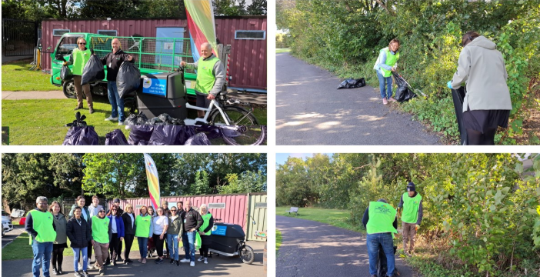
SBD Event: Community Clean Up Morning
September 11th
Join the growing list of companies taking part — your team is invited too
Date: Thursday, September 11th
Time: 9:30 AM – 11:30 AM (Join us for the full two hours or drop in whenever you can!)
Meeting Point: Naomh Ólaf GAA Club Car Park
Join local companies & community volunteers
Help clean Blackthorn Park & other District locations
Enjoy tea & coffee as a thank you ☕

Slide 11


SBD Event: Culture Night
September 19th
Join us for a vibrant evening of culture and cuisine at Sandyford Business District’s Culture Night
Date: Friday, September 19th
Time: 7:00 PM – 9:00 PM
Venue: Dynamic Space, 60 Holly Avenue, Stillorgan Business Park
This FREE event will feature the Dublin Symphony Orchestra performing Music from the Movies, alongside some of The District’s top restaurants and drink suppliers. It promises to be an unforgettable evening of music, food, and community spirit—showcasing the very best of Sandyford Business District’s cultural vibrancy.

Slide 12



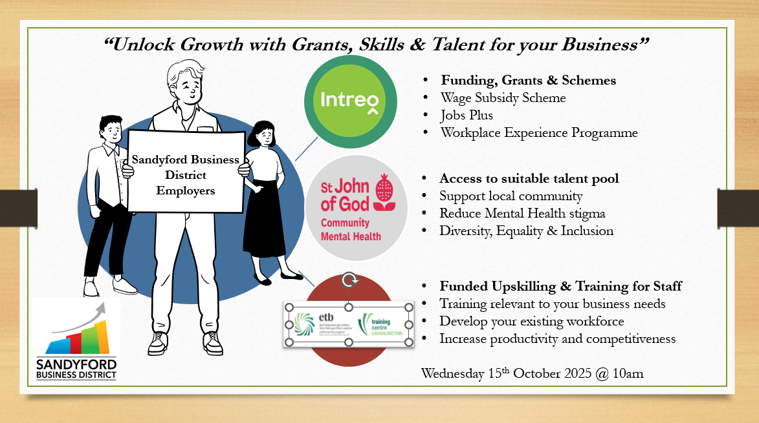
SBD Event: Employer Roadshow
October 15th
10AM- 11.30AM
In collaboration with
More details on flyers on the tables

Slide 13
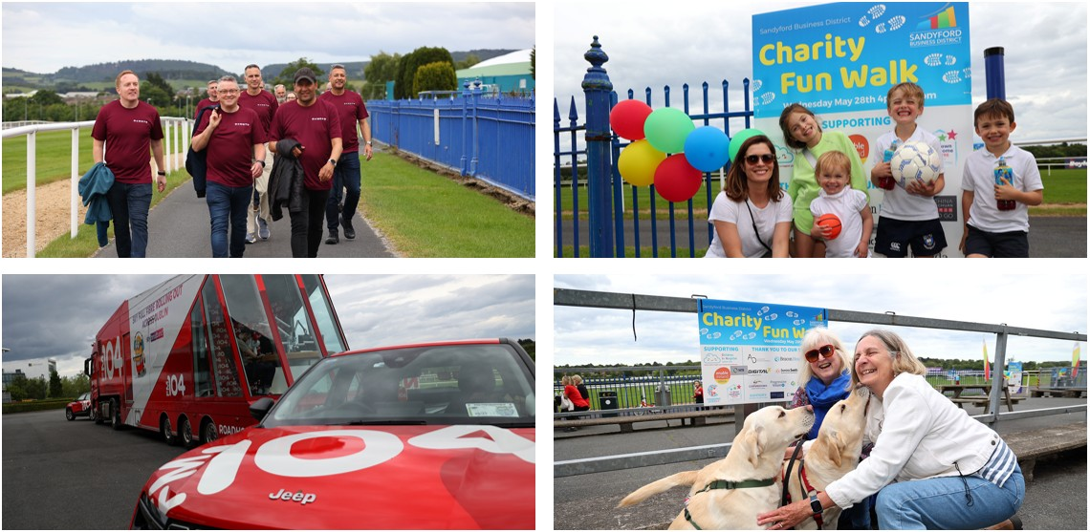
SBD Charity Fun Walk:
Wednesday May 28th we welcomed families and employees from across The District—and beyond—to our Charity Fun Walk in support of four incredible local charities all based here in The District:
Children in Hospital Ireland
The Down Syndrome Centre
Changing Lives DLR
Enable Ireland
Thanks to the many companies whose
generous support made the event possible
€10,200.42 was raised.
This amount will be shared equally among
the four charities, with each receiving €2,550.11

Slide 14


Slide 15
We want your feedback
Submissions for TD/Council Meeting – Share items or topics you’d like raised.
Thoughts on Civic Park – Any ideas, concerns, or suggestions.
Supports & Challenges – What supports do you need from us? Are you experiencing any issues?
Future Initiatives – What initiatives would you like us to explore for The District or your teams?
Anything else?

